Slide 1
MicroC/OS-II, 실시간 커널
성원호
디오이즈
www.dioiz.com

Slide 2
Student’s introduction
Name
Company affiliation
Title/function
Job responsibility
Programming experience
Experience with RTOS
Expectations for the course
Notes:
(1)

Slide 3
Prerequisites
Required
  Middle level experiences in C language
    Pointers, Linked Lists …
  Microprocessor programming
    At least, you must have a experience with one microprocessor
    Clear understanding of interrupt mechanism
Helpful
  Experiences with RTOS
  Multi tasking and Multi threaded programming
Notes:
(1)

Slide 4
Objectives
Have you understand:
  What a real-time kernel is
  How a kernel works
  How to use some of the features of a kernel
Help you decide whether:
  You need a kernel
  You can use a kernel
Notes:
(1)

Slide 5
Course outline
1st day
  Foreground/background systems
  Implementing software timer in F/B systems & real time kernel based systems
  Typical response problem in F/B systems & it’s solution by using a real time kernel (includes Labs)
  General introduction to real time systems
Notes:
(1)

Slide 6
Course outline continued..
2nd day
  Chapter 3, Kernel structure
  Chapter 4, Task management
  Chapter 5, Time management
  Lab : Examining kernel behavior using target hardware(DTB-196) & Oscilloscope
Notes:
(1)

Slide 7
Course outline continued..
3rd day
  Chapter 6, Event Control Blocks
  Chapter 7, Semaphore management
  Chapter 10, Message Mailbox management
  Chapter 11, Message Queue management
  Lab : Examples in the book and target hardware(DTB-196)
Notes:
(1)

Slide 8
Course outline continued..
4th day
  Chapter 12, Memory management
  Chapter 13, Porting MicroC/OS-II
    General requirements & porting to Intel x86 and 80c196kc
  Device drivers for MicroC/OS-II
    LCD, Keypad & Serial port driver provided with DTB-196
  MicroC/GUI and MicroC/FS demonstration
    This is an optional course. Only interested students may attend.
Notes:
(1)

Slide 9
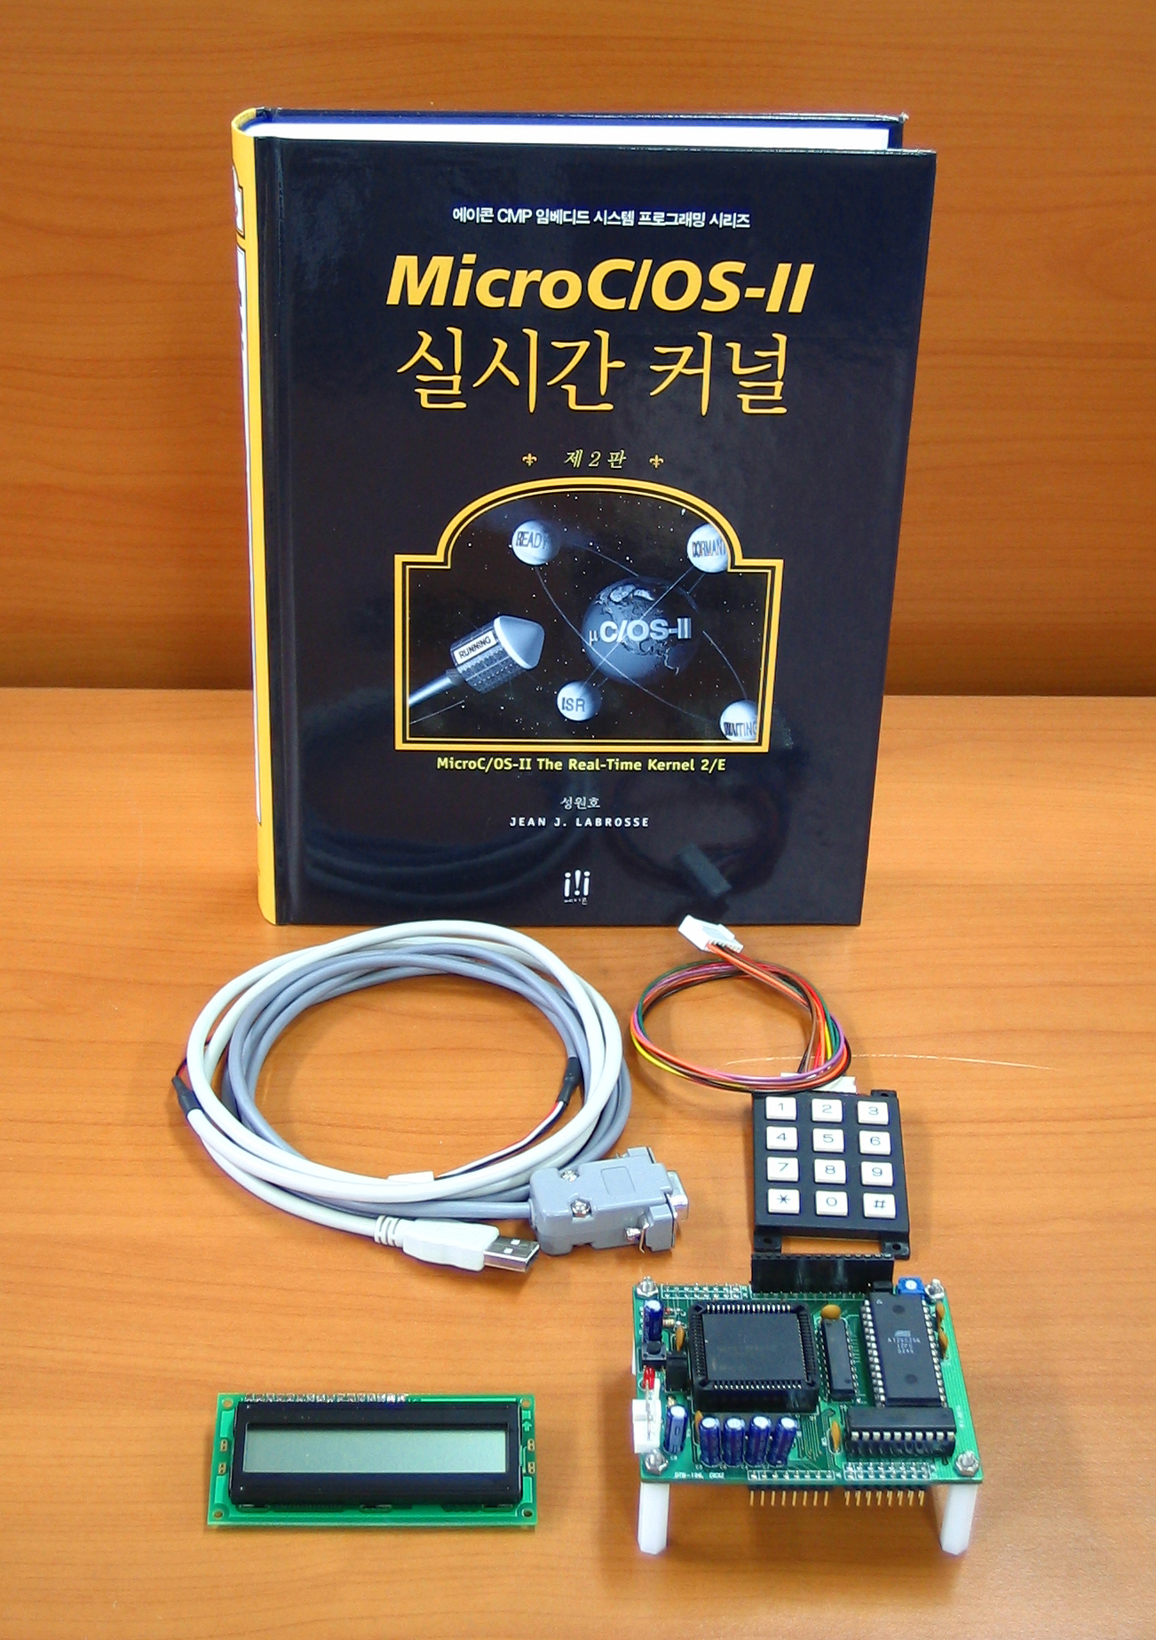
Course materials
1 PC/Person
The book
  MicroC/OS-II, The real time kernel 2nd edition
DTB-196
Notes:
(1)

Slide 10
Foreground/Background Systems
(Products without kernel)
Foreground #2
ISR #2
Foreground #1
ISR #1
ISR #1
Background
Task #1
Task #2
Task #3
Infinite loop
Time

Slide 11
Foreground/Background
/* Background */
void main (void)
{
Initialization;
FOREVER {
Read analog inputs;
Read discrete inputs;
Perform monitoring functions;
Perform control functions;
Update analog outputs;
Update discrete outputs;
Scan keyboard;
Handle user interface;
Update display;
Handle communication requests;
Other...
}
}
/* Foreground */
ISR (void)
{
Handle asynchronous event;
}

Slide 12
Foreground/Background
Advantages
Used in low cost Embedded Applications
Memory requirements only depends on your application
Single stack area for:
  Function nesting
  Local variables
  ISR nesting
Minimal interrupt latency
Low Cost
  No royalties to pay

Slide 13
Foreground/Background
Disadvantages
Background response time is the background execution time
  Non-deterministic
    Affected by if, for, while ...
  May not be responsive enough
  Changes as you change your code
All ‘tasks’ have the same priority!
  If an important event occurs it’s handled at the same priority as everything else!

Slide 14
Foreground/Background
Disadvantages
You have to implement all services:
  Time delays and timeouts
  Timers
  Message passing
  Resource management
Code is harder to maintain and can become messy!

Slide 15
Foreground/Background
(Buzzer Beep Manager Example)
Requirements:
  We need to have a function that manages a ‘buzzer’ for annunciating alarms.
  Application code will invoke the manager to have it generate ‘beeps’ patterns based on alarm conditions.
  The application must continue after requesting the beep.
Application Interface:
  Beep(OnTime, OffTime, NumberOfTimes)
Notes:
Could be extended to add a queue for multiple ‘tasks’

Slide 16
Foreground/Background
(Buzzer Beep Manager Example)
typedef enum {
BEEP_IDLE,
BEEP_START,
BEEP_DELAY_ON,
BEEP_DELAY_OFF
} BEEP_STATE;
INT16U BeepTmrCnts;
INT8U BeepTimes; // Number of times
INT16U BeepOnTime; // Time in ticks Buzzer will be ON
INT16U BeepOffTime; // Time in ticks Buzzer will be OFF
BEEP_STATE BeepState;
Global variables for Beep module

Slide 17
Foreground/Background
(Buzzer Beep Manager Example)
void BeepInit (void)
BeepState = BEEP_IDLE;
BeepTmrCnts = 0;
Initialize and Start the BeepISR();
void Beep (INT8 on, INT8 off, INT8U times)
if (BeepState == BEEP_IDLE) {
BeepOnTime = on * ISR rate;
BeepOffTime = off * ISR rate;
BeepTmrCnts = BeepOnTime;
BeepTimes = times;
Turn Buzzer ON;
BeepState = BEEP_DELAY_ON;
else
/* A beep has already been requested! .. */
/* .. we could cancel the previous request. */

Slide 18
Foreground/Background
(Buzzer Beep Manager Example)
void BeepISR (void)
if (BeepTmrCnts > 0)
BeepTmrCnts--;
switch (BeepState)
case BEEP_IDLE:
case BEEP_DELAY_ON:
if (BeepTmrCnts == 0)
Turn BUZZER OFF;
BeepTmrCnts = BeepOffTime;
BeepState = DELAY_OFF;
case BEEP_DELAY_OFF:
if (BeepTmrCnts == 0)
BeepTimes--;
if (BeepTimes == 0)
BeepState = BEEP_IDLE;
else
Turn BUZZER ON;
BeepTmrCnts = BeepOnTime;
BeepState = BEEP_DELAY_ON;
Idle
ON
OFF

Slide 19
Foreground/Background
(Buzzer Beep Manager Example)
You have to use a time base:
  To keep track of the buzzer ON and OFF time
  Most likely from a hardware timer or, 50 or 60 Hz line frequency
  This could ‘consume’ a hardware resource
Create and Initialize an ISR
  Or call BeepISR() from another ISR
Need a state machine
Most of the beep code is in an ISR
  You generally want to keep ISRs short
Notes:
Could be extended to add a queue for multiple ‘tasks’

Slide 20
Foreground/Background
(Buzzer Beep Manager Example)
Code gets more complicated when multiple tasks need to issue beep messages
  ‘Beep’ handler needs to maintain a message queue (you need to add more code).
A kernel based implementation would be cleaner and more versatile …
Notes:
Could be extended to add a queue for multiple ‘tasks’

Slide 21
Real-Time Kernel
(Buzzer Beep Manager Example)
Message
Queue
typedef struct {
INT8U BeepTimes;
INT16U BeepOnTime;
INT16U BeepOffTime;
} BEEP_MSG;
void Beep (INT8U times, INT16U on, INT16U off)
BEEP_MSG *pmsg;
pmsg = Get beep message buffer from kernel;
pmsg->BeepTimes = times;
pmsg->BeepOnTime = on; // Time in sec.
pmsg->BeepOffTime = off; // Time in sec.
Send message ‘pmsg’ to beep task;
pmsg
BeepTimes
BeepOnTime
BeepOffTime
Notes:
Good example for simplicity
Bad example because task execution << Context switch time!

Slide 22
Real-Time Kernel
(Buzzer Beep Manager Example)
Message
Queue
Server Task
void BeepInit (void)
Create Beep message queue;
Create beep task;
void BeepTask (void)
BEEP_MSG *pmsg;
for (;;)
pmsg = Wait for Message;
while (pmsg->BeepTimes > 0) {
Turn Audio ON;
OSTimeDlyHMSM(0, 0, pmsg->BeepOnTime, 0);
Turn Audio OFF;
OSTimeDlyHMSM(0, 0, pmsg->BeepOffTime, 0);
pmsg->BeepTimes--;
}
Return beep message buffer to kernel;
Beep
Task
BeepTimes
BeepOnTime
BeepOffTime
Notes:
Good example for simplicity
Bad example because task execution << Context switch time!

Slide 23
Real-Time Kernel
(Buzzer Beep Manager Example)
Code is simpler and easier to maintain.
All the code is done at the task level and not the ISR level.
The kernel based code can ‘queue’ multiple beep requests
  Any task can request beeps
This task can be given a LOW priority and thus would not affect the response to higher priority tasks
Notes:
Could be extended to add a queue for multiple ‘tasks’

Slide 24
Before we get started...
Typical Foreground/Background system
process1
void main(void)
{
시스템 초기화;
인터럽트 활성화;
intFlag1 = intFlag2 = OFF;
intFlag3 = intFlag4 = OFF;
for(;;)
{
if(intFlag1==ON)
{
process1();
intFlag1 = OFF;
}
if(intFlag2==ON)
{
process2();
intFlag2 = OFF;
}
if(intFlag3==ON)
{
process3();
intFlag3 = OFF;
}
if(intFlag4==ON)
{
process4();
intFlag4 = OFF;
}
}
}
process4
process2
BYTE intFlag1,intFlag2,intFlag3,intFlag4;
#pragma interrupt ExtInt1(void)
{
Process external interrupt 1;
intFlag1 = ON;
}
.
.
#pragma interrupt ExtInt4(void)
{
Process external interrupt 4;
intFlag4 = ON;
}
process3

Slide 25
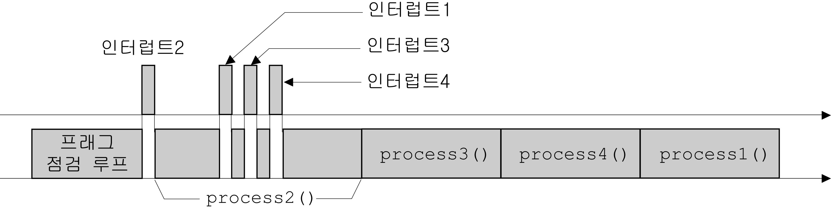
Before we get started...
Time characteristics(responsiveness)
of typical F/B systems

Slide 26
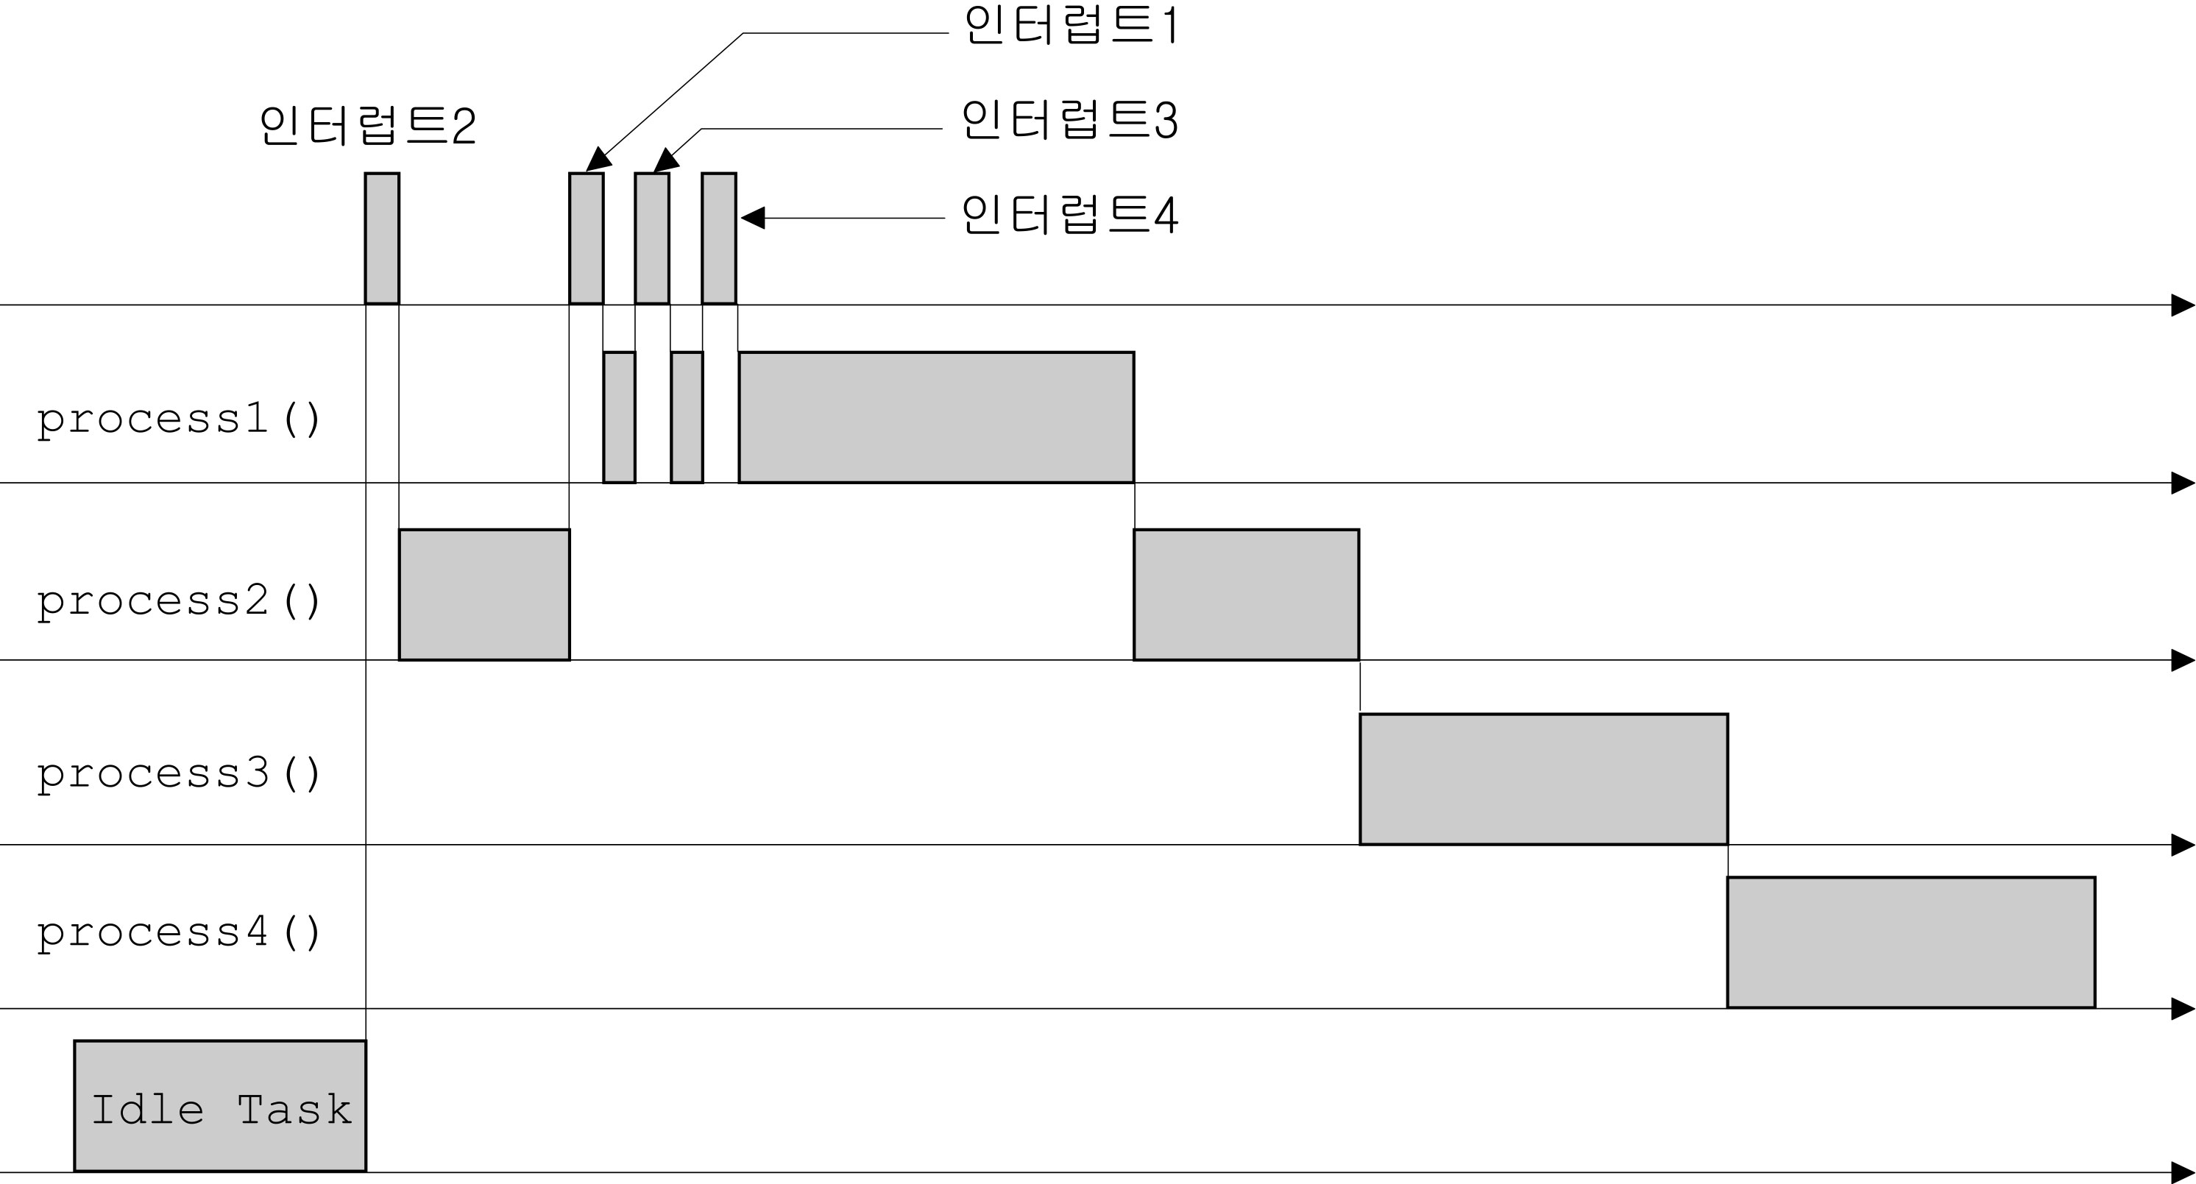
Before we get started...
Kernel based system

Slide 27
What is a Real-Time Kernel?
Software that manages the time of a microprocessor or microcontroller.
  Ensures that the most important code runs first!
Allows Multitasking:
  Do more than one thing at the same time.
  Application is broken down into multiple tasks each handling one aspect of your application
  It’s like having multiple CPUs!
Provides valuable services to your application:
  Time delays
  Semaphore management
  Intertask communication and synchronization

Slide 28
Why use a Kernel?
To be more responsive to real-time events
To prioritize the work to be done by the CPU
To simplify system expansion
  Adding low-priority tasks generally does not change the responsiveness to higher priority tasks!
To reduce development time

Slide 29
Why use a Kernel?
To easily split the application between programmers
  Can simplify debugging
To make documentation easier to maintain
To get useful services from the kernel
  Services that you would want to provide to your application code

Slide 30
Can you use a Kernel?
Depends on the processor!
  4-bit CPUs can’t
  8-bit CPUs can
  16-bit CPUs should
  32-bit+ CPUs is highly recommended!
Do you have enough ROM ?
  4K to 250K+ bytes extra

Slide 31
Can you use a Kernel?
Do you have enough RAM ?
  Kernel RAM
    20 to 350 bytes per task
  Task stacks
    Each task requires its own stack!
Kernel will disable interrupts!
Can your application afford the extra costs?

Slide 32
What are the Costs?
Kernel itself
  Development Seats
    $50 to $10,000 per seat
  Some Kernels require royalties
  Maintenance for upgrades and bug fixes
    Typically 15% (of initial cost) per year
Extra ROM
  May mean bigger chip(s)
Extra RAM
  May mean bigger chip(s)

Slide 33
What are the Costs?
Learning curve
  Couple of days to a few weeks
Need reentrant functions
Need to be careful with shared resources
Adds CPU overhead

Slide 34
Designing with a Kernel
(Splitting an application into Tasks)
High Priority Task
Task
Task
Each Task
Importance
Task
Event
Event
Task
Task
Low Priority Task
Task
Infinite Loop

Slide 35
Types of Kernels
(Non-Preemptive)
Interrupt Occurs
Vector to ISR
ISR make High Priority Task Ready
ISR
Completes
(Return to Task)
ISR
ISR
High Priority Task
Low Priority Task
Low Priority Task
Completes
(Switch to HP Task)

Slide 36
Types of Kernels
(Preemptive)
Interrupt Occurs
Vector to ISR
ISR make High Priority Task Ready
ISR
Completes
(Switch to HP Task)
ISR
ISR
High Priority Task (HPT)
Low Priority Task (LPT)
HP Task Completes
(Switch back to LP Task)

Slide 37
An Overview of RTOS
What is?
  Manages time scheduling of each tasks.
  guarantees a certain capability within a specified time constraint (responsiveness)
Why use?
  Applications are becoming more complex.
    Responsiveness must be guaranteed.
  Hardware resources are getting cheaper.
  Easy to design and maintain application software.
    Some backgrounds of RTOS are needed.

Slide 38
Requirements in Implementing RTOS
At least one timer(internal or external) to generate regular interrupt for time slicing.
Plenty of ROM and RAM for OS kernel and task contexts (TCB, stack..).
C compiler that generates reentrant code.
Interrupts can be disabled and enabled from C
Instruction that move register’s contents to stack or from stack to registers.

Slide 39
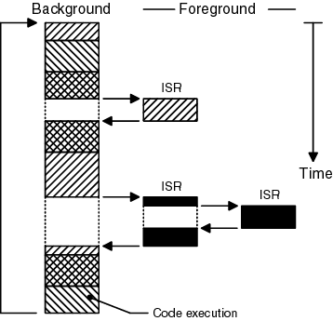
Foreground/Background systems

Slide 40
Critical section of code
Also called ‘critical region’ -Atomic
When executing this region, interrupts
never occur(disabled).
Execution time must be as short as possible.
.
.
Load Rx, [g_TotalCnt]
Inc Rx
Store [g_TotalCnt], Rx
.
.
.
.
g_TotalCnt = g_TotalCnt +1;
.
.

Slide 41
Resources and Shared resources
Resources
  Any objects or entity such as memory(variable, array and structures), peripheral devices and I/O used by tasks.
Shared resources
  Resources used by several tasks.
  Exclusive access (Mutual exclusion) must be guaranteed to access shared resource.

Slide 42
Multitasking
Process of scheduling and switching the CPU between several tasks.

Slide 43
Task (Thread)
A simple program or function that thinks it has the CPU all to itself.
Each task is assigned a priority, its own set of CPU registers, and its own stack
A task is in any of these states
  Dormant, Ready, Running, Waiting, ISR

Slide 44
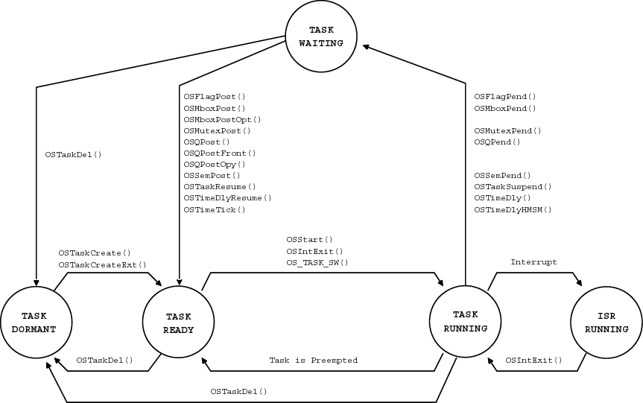
Task (Thread)
Task states

Slide 45
Context switch (Task switch)
When a kernel decides to run a different task, it simply saves the current task’s context and the new task’s context is restored from its stack.
This process adds overhead to the CPU.
The more registers a CPU has, the higher the overhead.

Slide 46
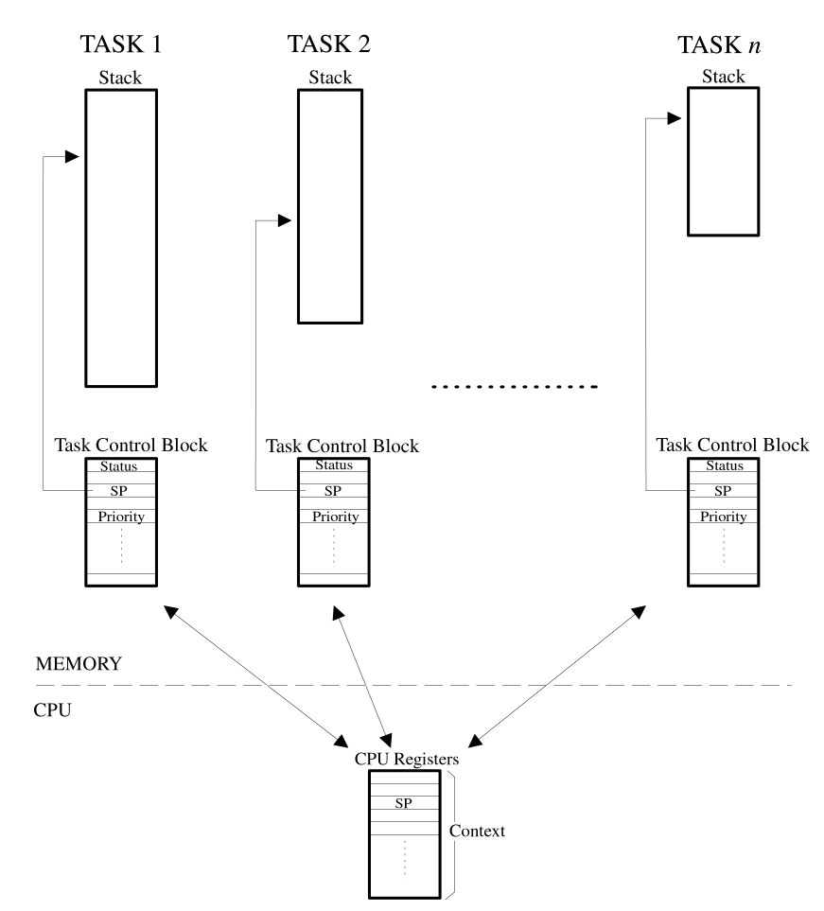

Slide 47
Kernel
An integral part of an Multitasking system responsible for managing the tasks and communication between tasks.
Context switching is the fundamental service of the kernel.
Scheduler
  Determines which task will run next
  Most kernels have priority based scheduler

Slide 48
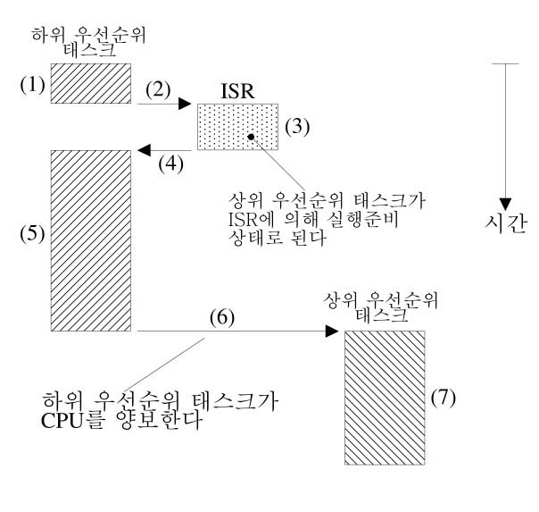
Kernel (continued)
Non-preemptive kernel
  Tasks must explicitly give up control of the CPU.
  ISR always returns to the interrupted task.

Slide 49
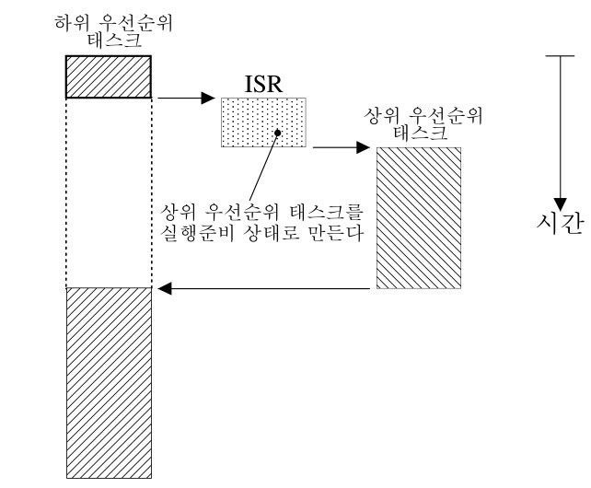
Kernel (continued)
Preemptive kernel
  Task level responsiveness is better than non preemptive kernels and deterministic.
  A task must use reentrant functions and mutual exclusion must be guaranteed when accessing shared resources

Slide 50
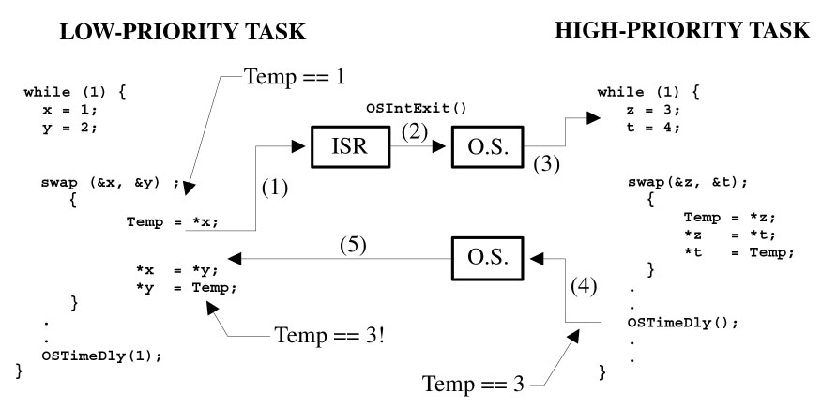
Reentrancy
Possibilities of use by several tasks.
Reentrant function
  A task can use reentrant function without fear of data corruption
  Uses local variables or protect data when global variables are used.

Slide 51
Reentrancy (continued)
Non reentrant problem can be solved by following methods.
  Use local variables as temporary purpose.
  Make critical region when accessing global variables.
  Use a semaphore

Slide 52
Round-robin scheduling
When two or more tasks with the same priority are in ready state, the kernel allows one task to run for a predetermined time, called quantum, then selects next task.

Slide 53
Priority
Task priority
  Mainly used by scheduler when it needs to determine which task will run next.
  The more important the task, the higher the priority given to it.
Static priorities
Dynamic priorities
  Desirable feature of real-time kernel to avoid priority inversions discussed next.

Slide 54
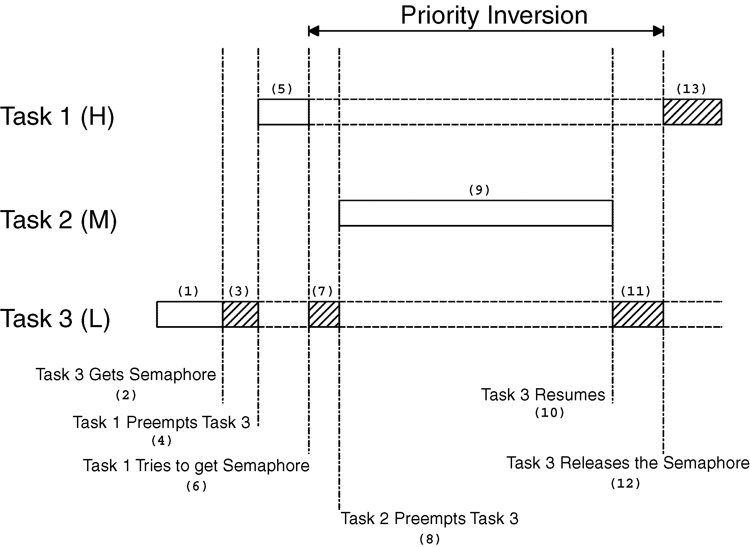
Priority Inversions

Slide 55
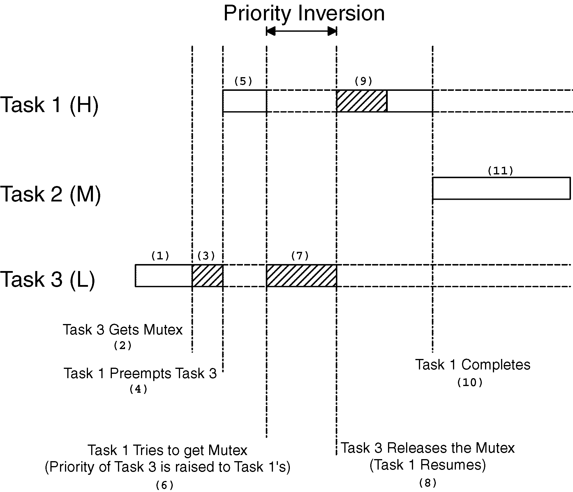
Priority Inversions

Slide 56
Mutual exclusion
To access shared resources between tasks,
mutual exclusion must be guaranteed to prohibit data corruption.
Common methods to acquire mutual exclusion.
  Disabling interrupt
  Test and set operation
  Disabling scheduler
  Semaphores

Slide 57
Mutual exclusion (continued..)
Disabling and enabling interrupts
  The easiest and fastest way to gain exclusive access to a shared resource as shown in the pseudocode
  Do not disable interrupts for too long because this affects the response of the system. Also, it can cause the system to loose incoming event and data.
Disable interrupt;
Access the resource;
Enable interrupt;
OS_ENTER_CRITICAL();
Access the resource;
OS_EXIT_CRITICAL();

Slide 58
Mutual exclusion (continued..)
Test and set
  This method is mainly used by foreground/background system.
Disable interrupt;
if(‘Access variable’ is 0){
Set variable to 1;
Enable interrupt;
Access the resource;
Disable interrupt;
Set the ‘Access variable’ back to 0;
Enable interrupt;
}else{
Enable interrupt;
/* You don’t have access to the resource, try back later */
}

Slide 59
Mutual exclusion (continued..)
Disabling and enabling scheduler
  A task should not share resources with an ISR
  While the scheduler is locked, interrupts are still enabled.
  ISR will always return to interrupted task.
  Not recommended. Use semaphores.
OSSchedLock();
Access the resource (interrupts are allowed);
OSSchedUnlock();

Slide 60
Mutual exclusion (continued..)
Semaphores
  Semaphores are used to..
    Control access to a shared resource(mutual exclusion)
    Signal the occurrence of an event
    Allow two tasks to synchronize their activities
  A key that a task must acquire in order to continue execution.
  Binary and counting semaphores
    Each semaphore has its own 8, 16, or 32bit counter depending on the system
  Operations on semaphores
    Initialize(Create), Wait(Pend), Signal(Post)

Slide 61
Mutual exclusion (continued..)
  Using semaphores (binary semaphore)
  Semaphore is simply a data structure managed by a kernel. Three operations are possible in uC/OS-II.
    When a initialization function is called, the kernel returns available structure pointer to the caller.
    A Wait(pending) operation is performed on semaphore by a task to access shared resource
    If the semaphore is available(counter is greater than 0), the counter is decremented and the task continues execution
    If not available(counter is 0), the task is suspended and placed in the semaphore’s wait list. Then task switching occurs.
    If wait operation is performed with timeout and the time
    expires, wait operation returns error code to indicate a timeout has occurred. So, care is needed.
    When the task finishes use of shared resource, semaphore must be signaled using signaling function to allow other task to use that resource.

Slide 62
Mutual exclusion (continued..)
Encapsulating semaphore
    There are situations when it is better to encapsulate the semaphore. For example, if several tasks use CommSendCmd() to send command using RS-232 port. It’s better to encapsulate the semaphore internally.
INT8U CommSendCmd(char *cmd, char *response, INT16U timeout)
{
Acquire port’s semaphore;
Send command to device;
Wait for response (with timeout);
if(timed out){
Release semaphore;
return (error code);
}else{
Release semaphore;
return (no error);
}
}

Slide 63
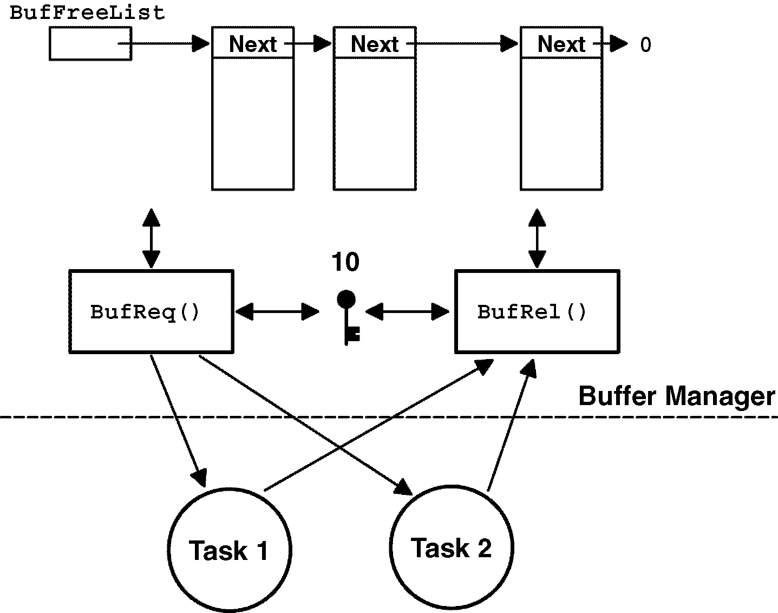
Mutual exclusion (continued..)
Buffer management
BUF *BufReq(void)
{
BUF *ptr;
Acquire a semaphore;
Disable interrupts;
ptr = BufFreeList;
BufFreeList = ptr->BufNext;
Enable interrupts;
return (ptr);
}
void BufRel(BUF *ptr)
{
Disable interrupts;
ptr->BufNext = BufFreeList;
BufFreeList = ptr;
Enable interrupts;
Release semaphore;
}

Slide 64
Deadlock
A situation in which two tasks are unknowingly waiting for resources held by each other.
  Assume that task1 has exclusive access to R1 and task2 has exclusive access to R2. If task1 needs exclusive access R2 and task2 needs exclusive access R1. They are deadlocked.
  Solutions are..
    Acquire all resources before proceeding.
    Acquire resources in the same order
    Release resources in the reverse order.

Slide 65
Synchronization
Semaphores can be used to synchronize tasks and ISR. In this case, it must be initialized with zero count
Unilateral synchronization
  ISR to task, task to task
Bilateral synchronization
  Only task to task

Slide 66
Event flags
Event flags are used when a task needs to synchronize with the occurrence of multiple events
Disjunctive and conjunctive events
Kernel supporting event flags offer services to SET event flags, CLEAR event flags, and WAIT event flags

Slide 67
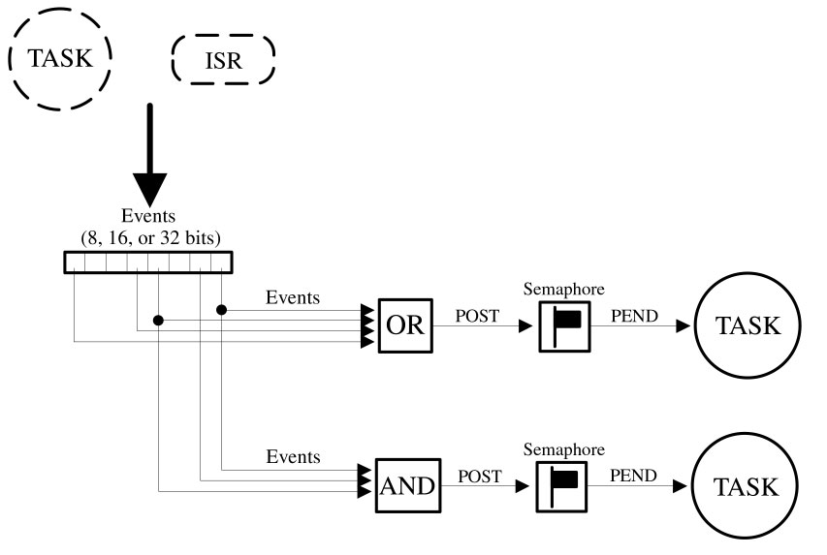
Event flags

Slide 68
Intertask communication
Between tasks, it is possible to communicate with each other using
  Global variables
  Messages
  provided that mutual exclusive access is guaranteed
Between task and ISR, they only can communicate with each other using global variables

Slide 69

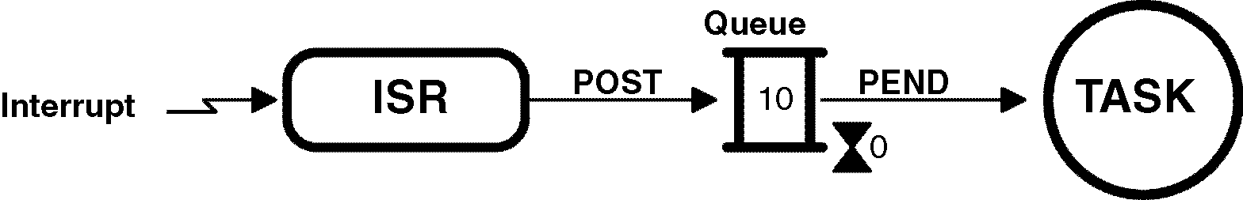
Intertask communication
Message Mailboxes
Message Queue

Slide 70
Interrupts
A hardware mechanism used to inform the CPU that an asynchronous event has occurred.
Once an interrupt recognized, CPU’s PC(program counter) is automatically loaded with corresponding ISR vector and jumps.
ISR should be as short as possible. Otherwise,
other events may be lost.

Slide 71
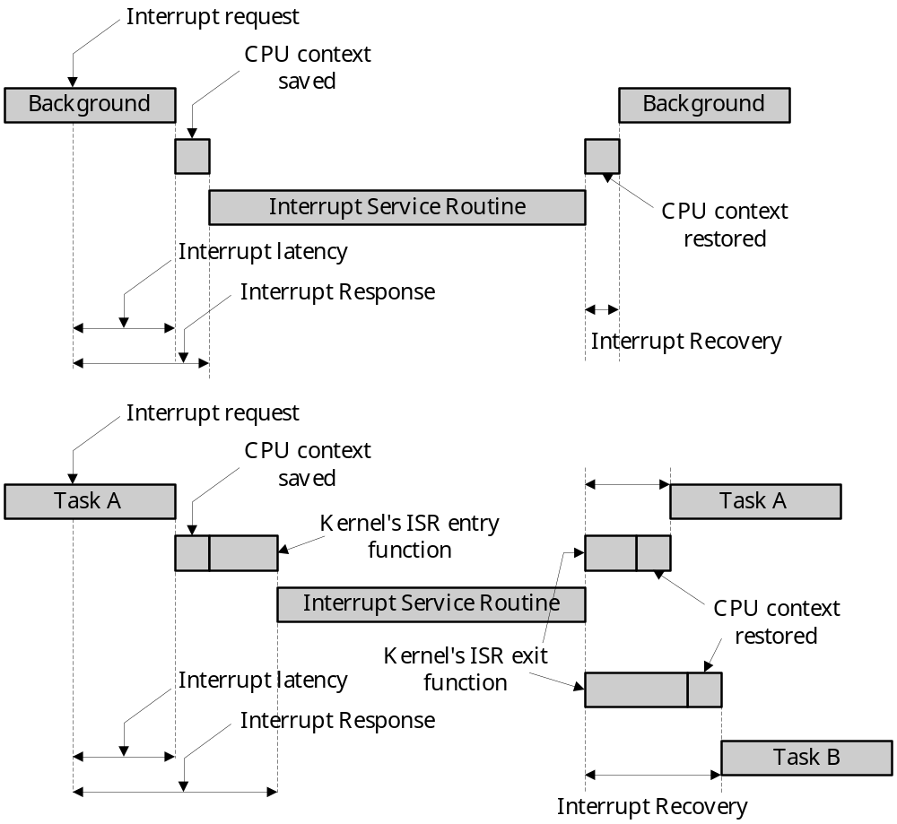
ISR processing time

Slide 72
Clock tick
A heart beat in the real time system.
Typical duration is between 10 and 200msec
Task switching occurs when a task suspended with Sleep function (in uC/OS-II, OSTimeDly()) reaches timeout.
The resolution of delayed tasks is one clock tick. This doesn’t mean its accuracy is one tick

Slide 73
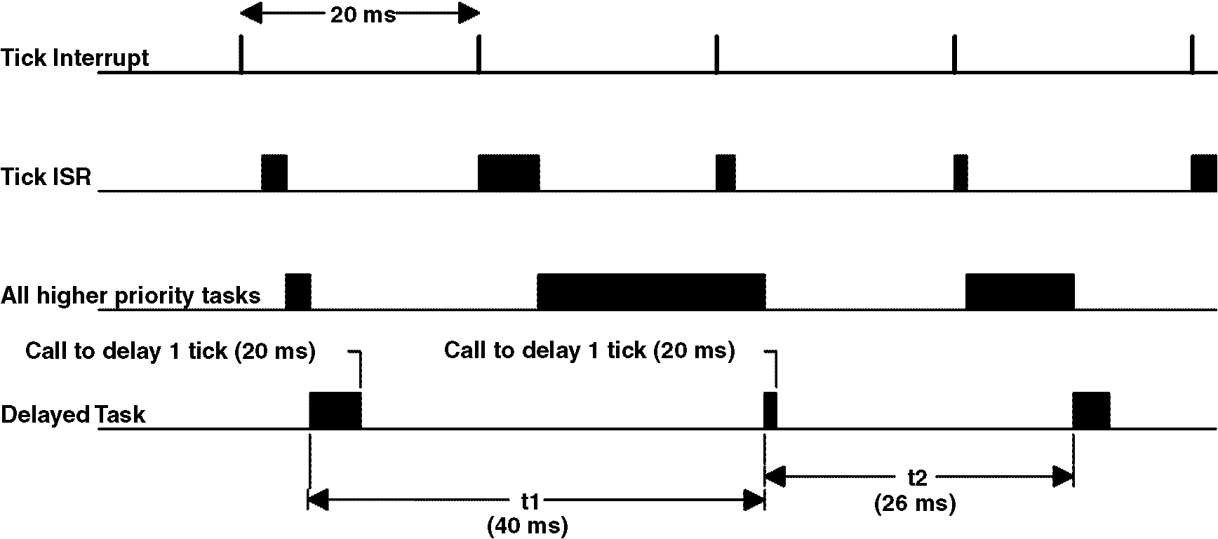
Clock tick (Case 1)

Slide 74
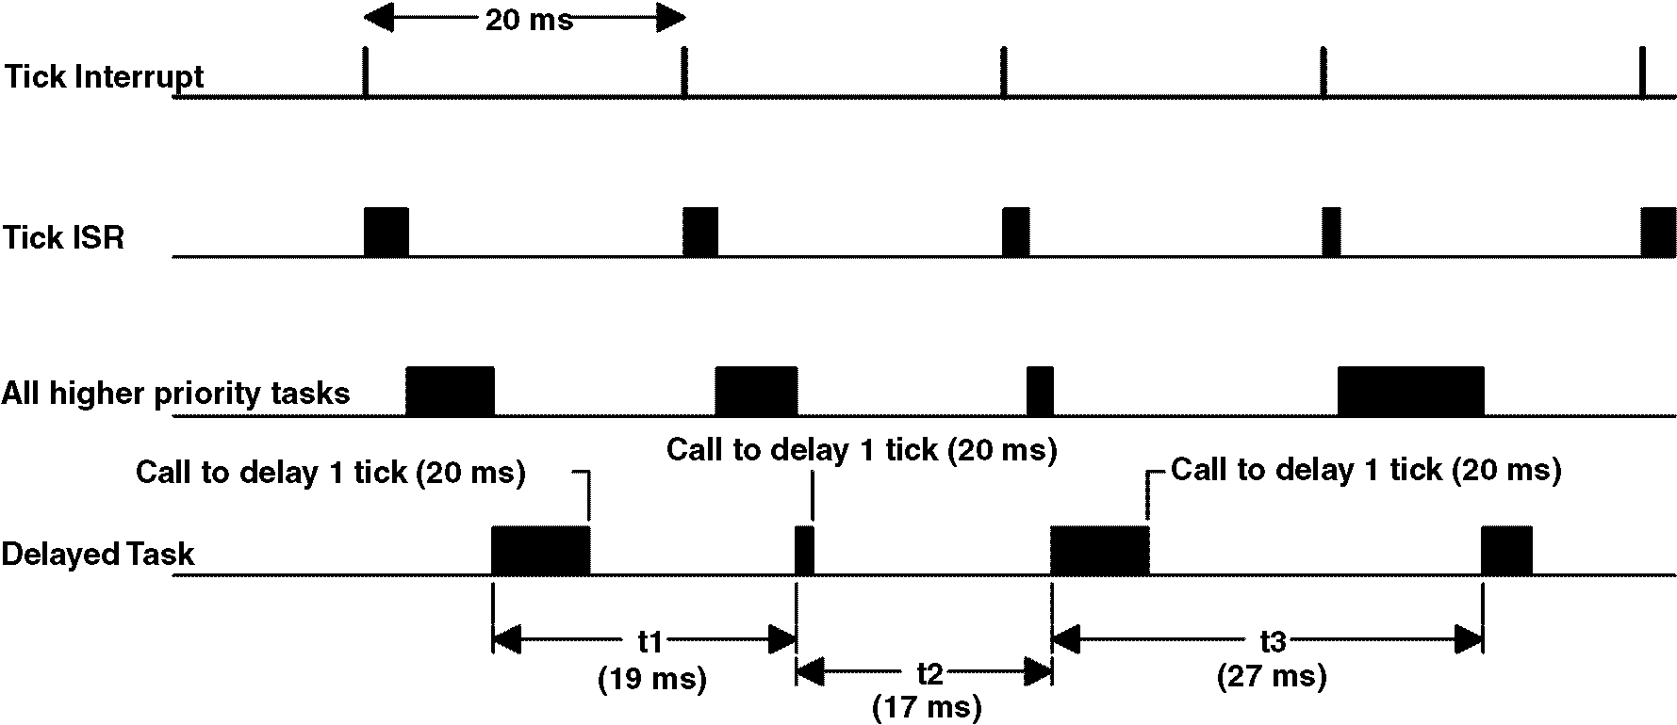
Clock tick (Case 2)

Slide 75
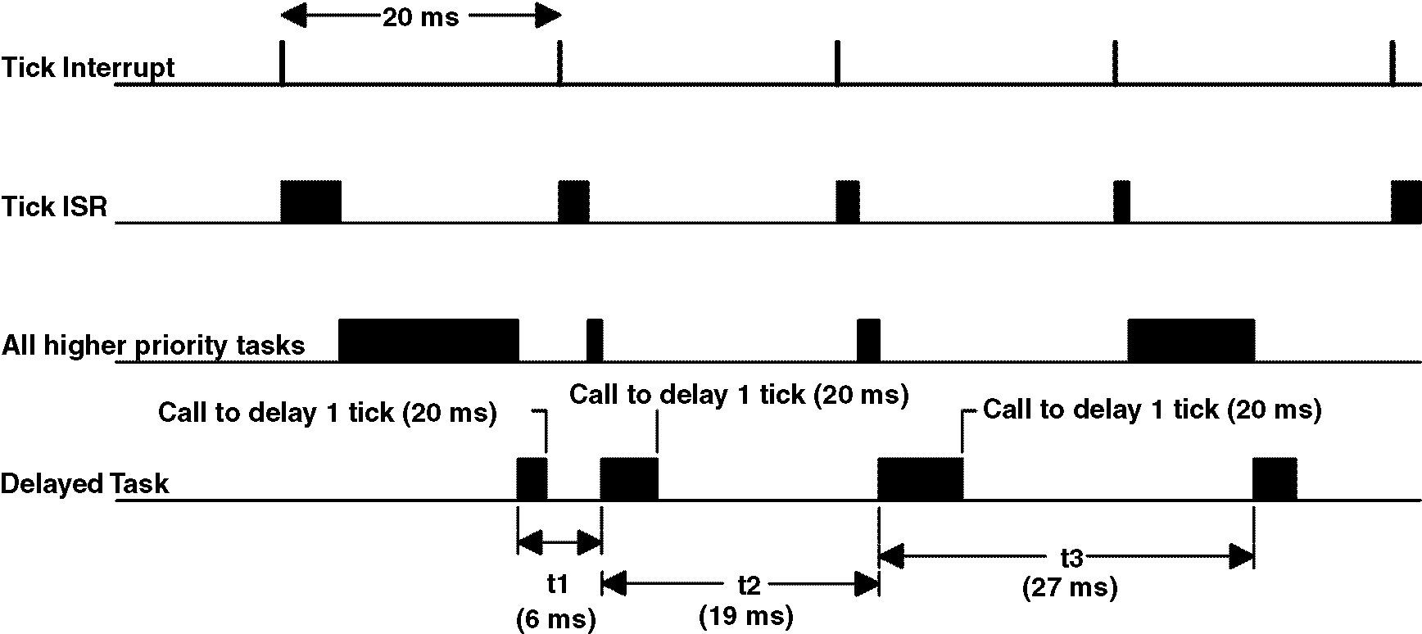
Clock tick (Case 3)

Slide 76
Memory Requirements
Application code size + Kernel code size
Application code requirements
+ Data space (i.e., RAM) needed by the kernel itself
+ SUM(task stacks + MAX(ISR nesting))
Application code requirements
+ Data space (i.e., RAM) needed by the kernel
+ SUM(task stacks)
+ MAX(ISR nesting)

Slide 77
Advantages and Disadvantages of Real-Time Kernels
Improved responsiveness
Easy maintenance of Application
System overhead
More memory is required
License costs

Slide 78
Chapter 3. Kernel structure
What we’ll learn in this chapter
  how uC/OS-II handles access to critical sections of code,
  what a task is
  how uC/OS-II knows about your tasks,
  how tasks are scheduled,
  how uC/OS-II determines the percent CPU your application is using,
  how to write interrupt service routines (ISR),
  what a clock tick is, how uC/OS-II handles them,
  how to initialize uC/OS-II, and
  how to start multitasking.

Slide 79
Core services configuration constants in OS_CFG.H.
uC/OS-II Core Service | Enabled when set to 1 in OS_CFG.H
OS_ENTER_CRITICAL()
OS_EXIT_CRITICAL()
OSInit()
OSStart()
OSIntEnter()
OSIntExit()
OSSchedLock() | OS_SCHED_LOCK_EN
OSSchedUnlock() | OS_SCHED_LOCK_EN
OSVersion()

Slide 80
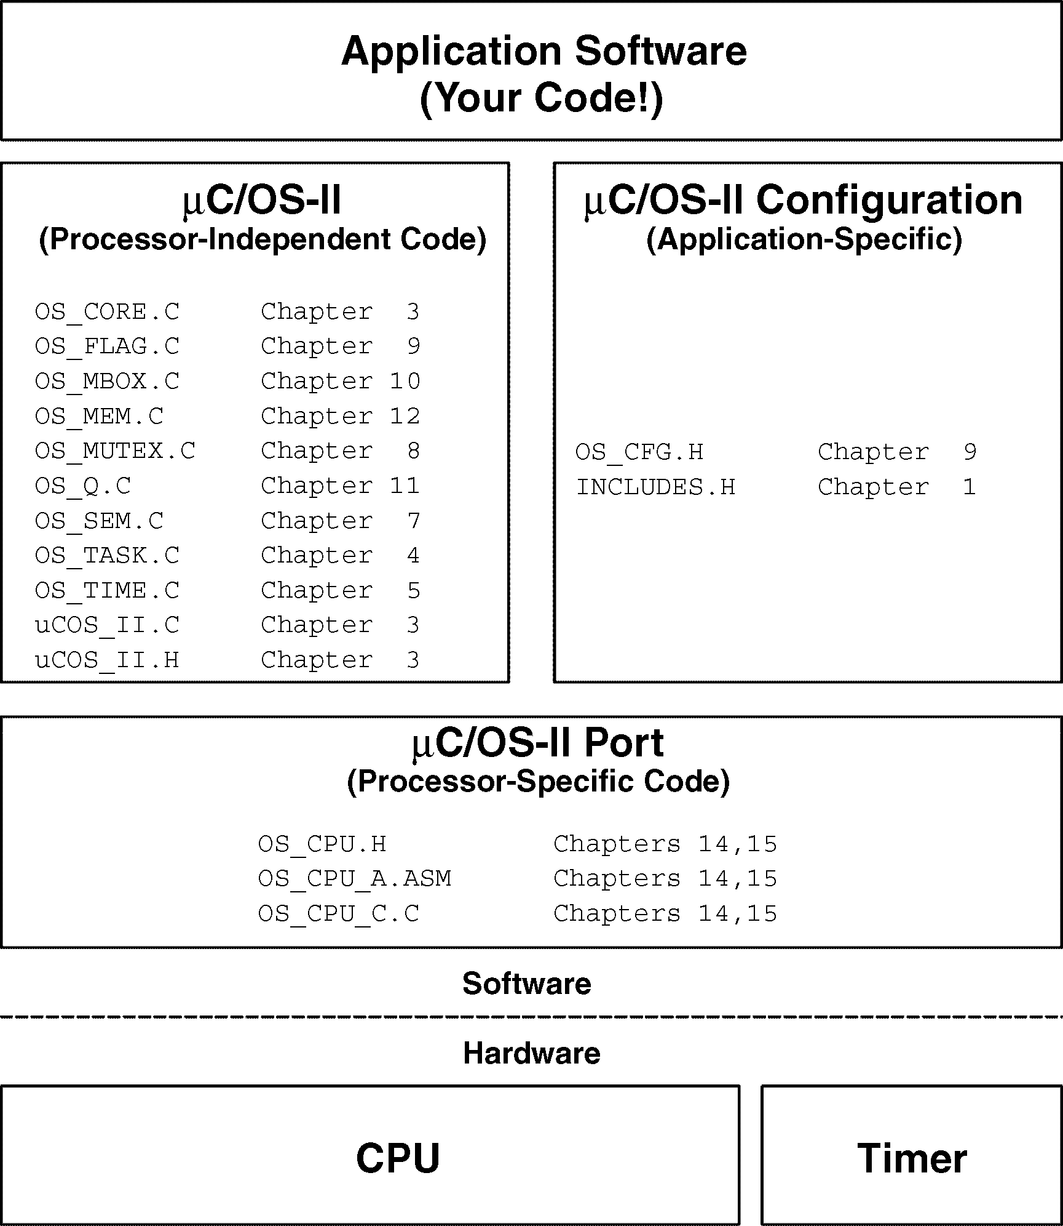
uC/OS-II file structure

Slide 81
Critical Sections, OS_ENTER_CRITICAL() and OS_EXIT_CRITICAL()
OS_CRITICAL_METHO==1
OS_CRITICAL_METHO==2
OS_CRITICAL_METHO==3
.
OS_ENTER_CRITICAL();
/* uC/OS-II critical code section */
OS_EXIT_CRITICAL();
.
#define OS_ENTER_CRITICAL() \
asm(“ PUSH PSW”) \
asm(“ DI”)
#define OS_EXIT_CRITICAL() \
asm(“ POP PSW”)

Slide 82
Tasks
A task is an infinite loop or …
void YourTask (void *pdata)
{
for (;;){
/* USER CODE */
Call one of uC/OS-II’s services:
OSFlagPend();
OSMboxPend();
OSMutexPend();
OSQPend();
OSSemPend();
OSTaskDel(OS_PRIO_SELF);
OSTaskSuspend(OS_PRIO_SELF);
OSTimeDly();
OSTimeDlyHMSM();
/* USER CODE */
}
}
void YourTask (void *pdata)
{
/* USER CODE */
OSTaskDel(OS_PRIO_SELF);
}

Slide 83
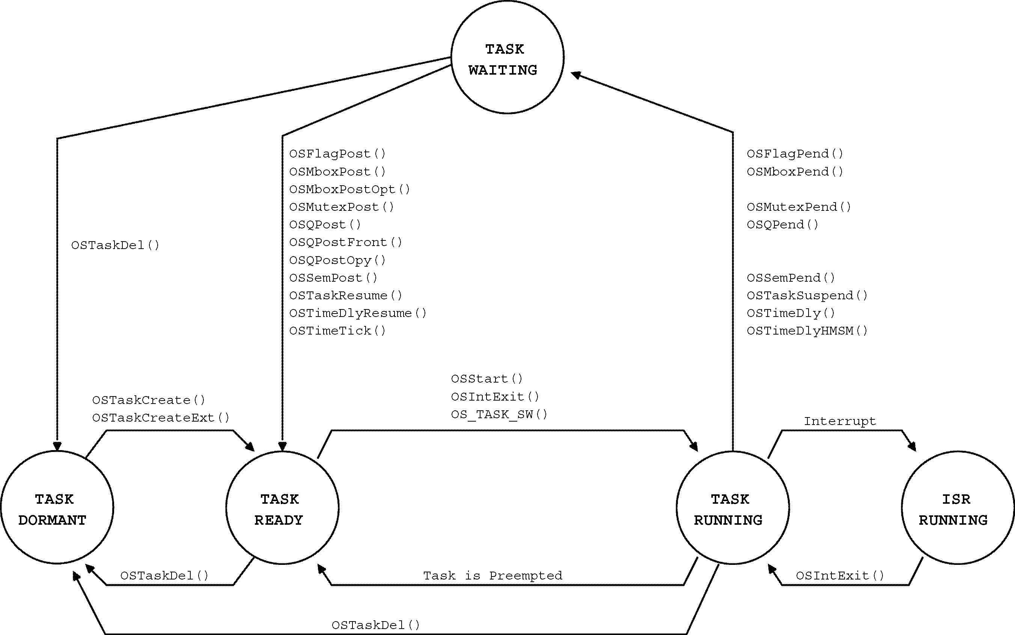
Task states

Slide 84
Task Control Block (TCB)
typedef struct os_tcb {
OS_STK *OSTCBStkPtr;
#if OS_TASK_CREATE_EXT_EN > 0
void *OSTCBExtPtr;
OS_STK *OSTCBStkBottom;
INT32U OSTCBStkSize;
INT16U OSTCBOpt;
INT16U OSTCBId;
#endif
struct os_tcb *OSTCBNext;
struct os_tcb *OSTCBPrev;
#if ((OS_Q_EN > 0) && (OS_MAX_QS > 0)) || (OS_MBOX_EN > 0) || (OS_SEM_EN > 0) || (OS_MUTEX_EN > 0)
OS_EVENT *OSTCBEventPtr;
#endif
#if ((OS_Q_EN > 0) && (OS_MAX_QS > 0)) || (OS_MBOX_EN > 0)
void *OSTCBMsg;
#endif

Slide 85
Task Control Block (TCB) (continued..)
#if (OS_VERSION >= 251) && (OS_FLAG_EN > 0) && (OS_MAX_FLAGS > 0)
#if OS_TASK_DEL_EN > 0
OS_FLAG_NODE *OSTCBFlagNode;
#endif
OS_FLAGS OSTCBFlagsRdy;
#endif
INT16U OSTCBDly;
INT8U OSTCBStat;
INT8U OSTCBPrio;
INT8U OSTCBX;
INT8U OSTCBY;
INT8U OSTCBBitX;
INT8U OSTCBBitY;
#if OS_TASK_DEL_EN > 0
BOOLEAN OSTCBDelReq;
#endif
} OS_TCB;

Slide 86
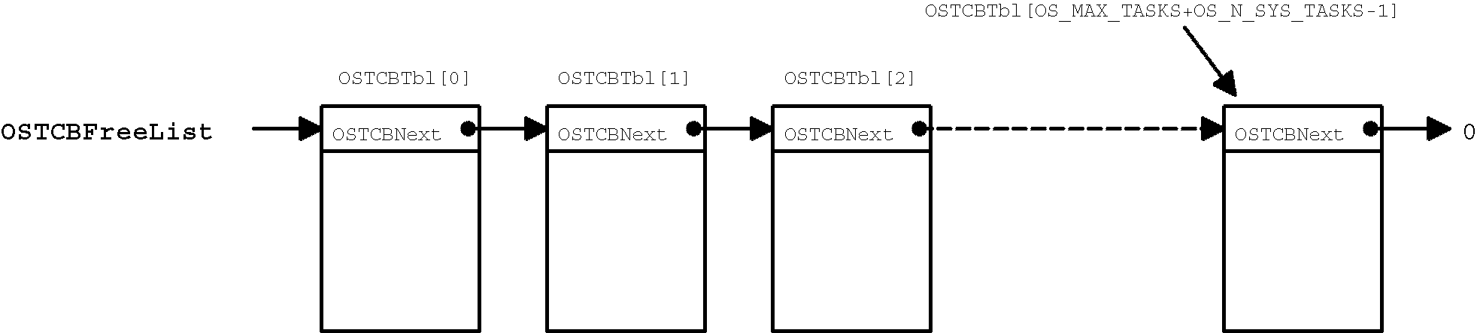
List of free OS_TCBs
Initialized by OS_TCBInit()

Slide 87
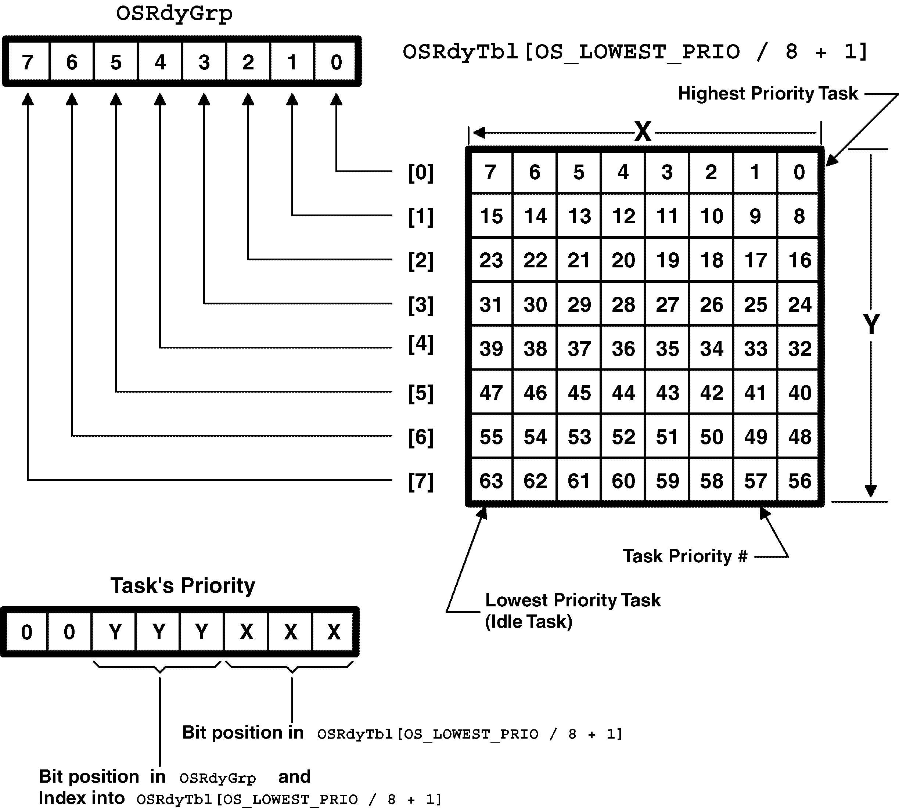
Ready List

Slide 88
Ready List (continued)
Making a task ready to run
Removing a task from the ready list
Finding the highest priority task ready to run
OSRdyGrp |= OSMapTbl[prio >> 3];
OSRdyTbl[prio >> 3] |= OSMapTbl[prio & 0x07];
if((OSRdyTbl[prio>>3] &= ~OSMapTbl[prio & 0x07]) == 0)
OSRdyGrp &= ~OSMapTbl[prio >> 3];
y = OSUnMapTbl[OSRdyGrp];
x = OSUnMapTbl[OSRdyTbl[y]];
prio = (y<<3) + x;

Slide 89
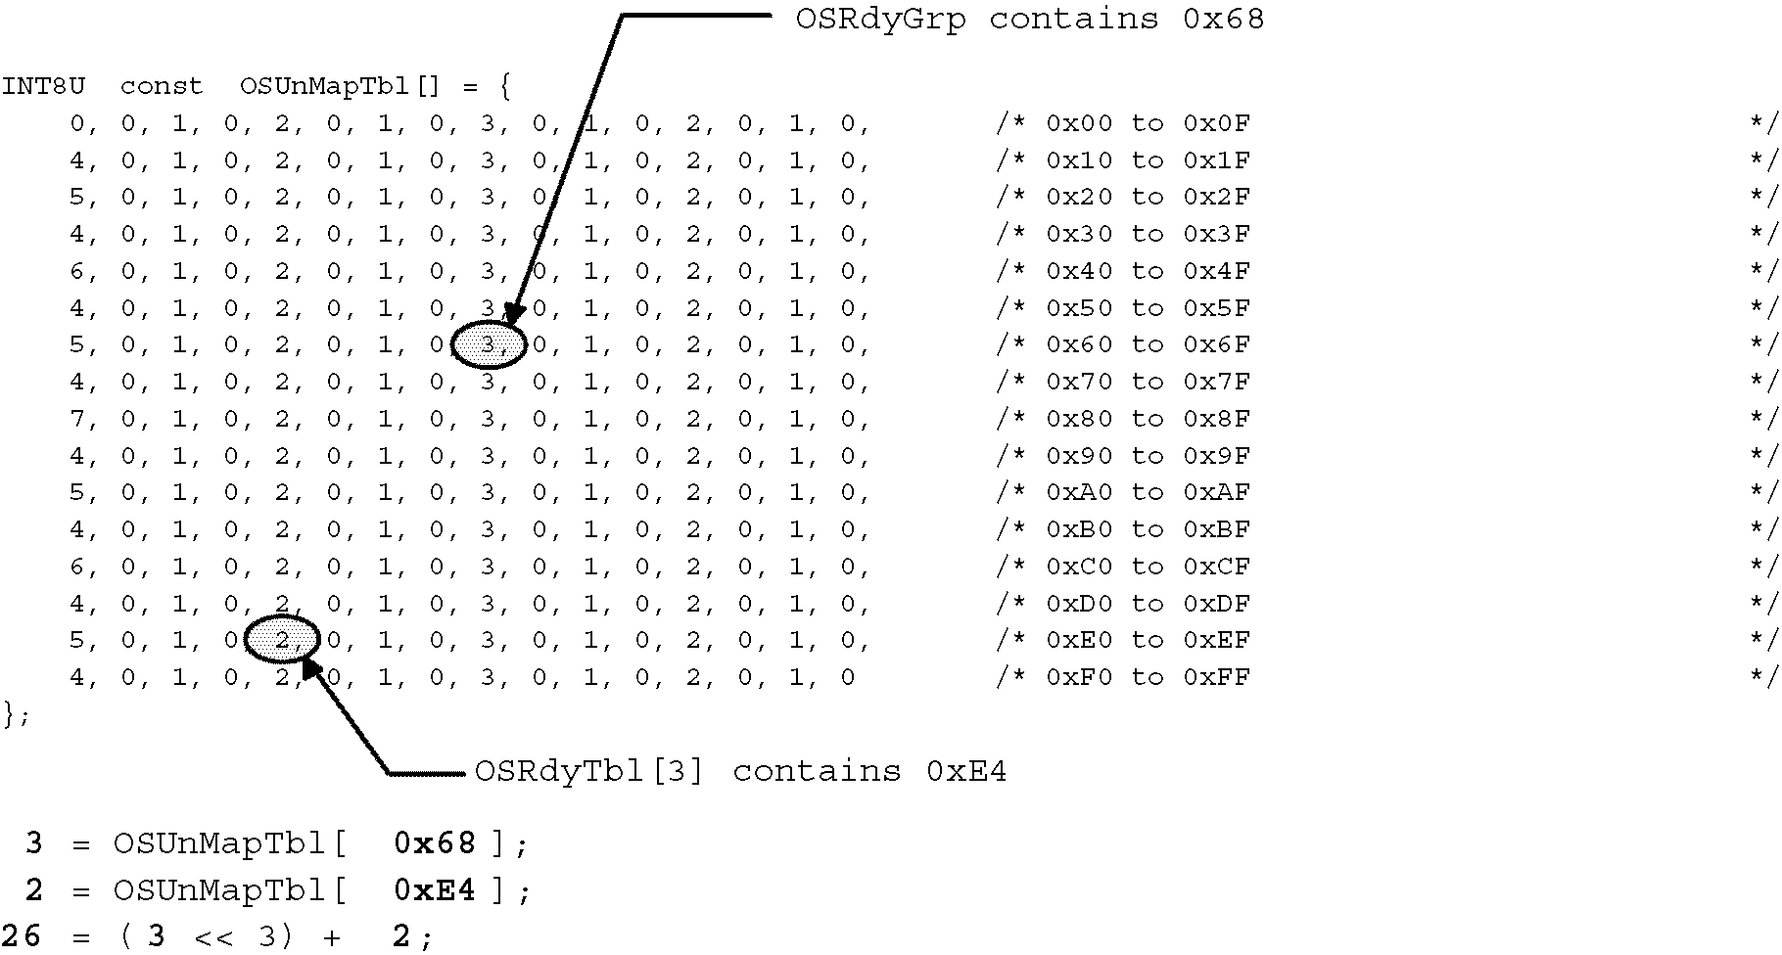
Ready List (continued)
Finding the highest priority task ready to run

Slide 90
Task Scheduling
Task level scheduling
void OS_Sched (void)
{
#if OS_CRITICAL_METHOD == 3
OS_CPU_SR cpu_sr;
#endif
INT8U y;
OS_ENTER_CRITICAL();
if ((OSIntNesting == 0) && (OSLockNesting == 0)) { (1)
y = OSUnMapTbl[OSRdyGrp]; (2)
OSPrioHighRdy = (INT8U)((y << 3) + OSUnMapTbl[OSRdyTbl[y]]);
if (OSPrioHighRdy != OSPrioCur) { (3)
OSTCBHighRdy = OSTCBPrioTbl[OSPrioHighRdy]; (4)
OSCtxSwCtr++; (5)
OS_TASK_SW(); (6)
}
}
OS_EXIT_CRITICAL();
}

Slide 91
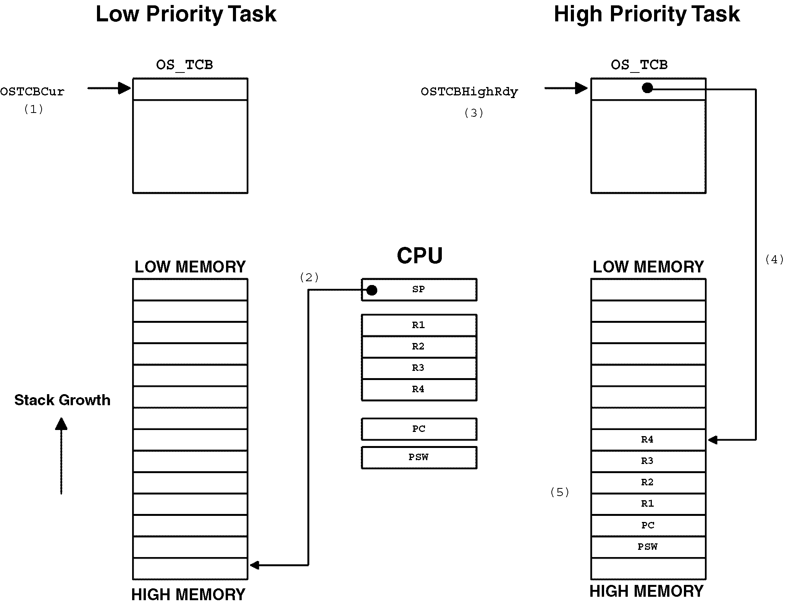
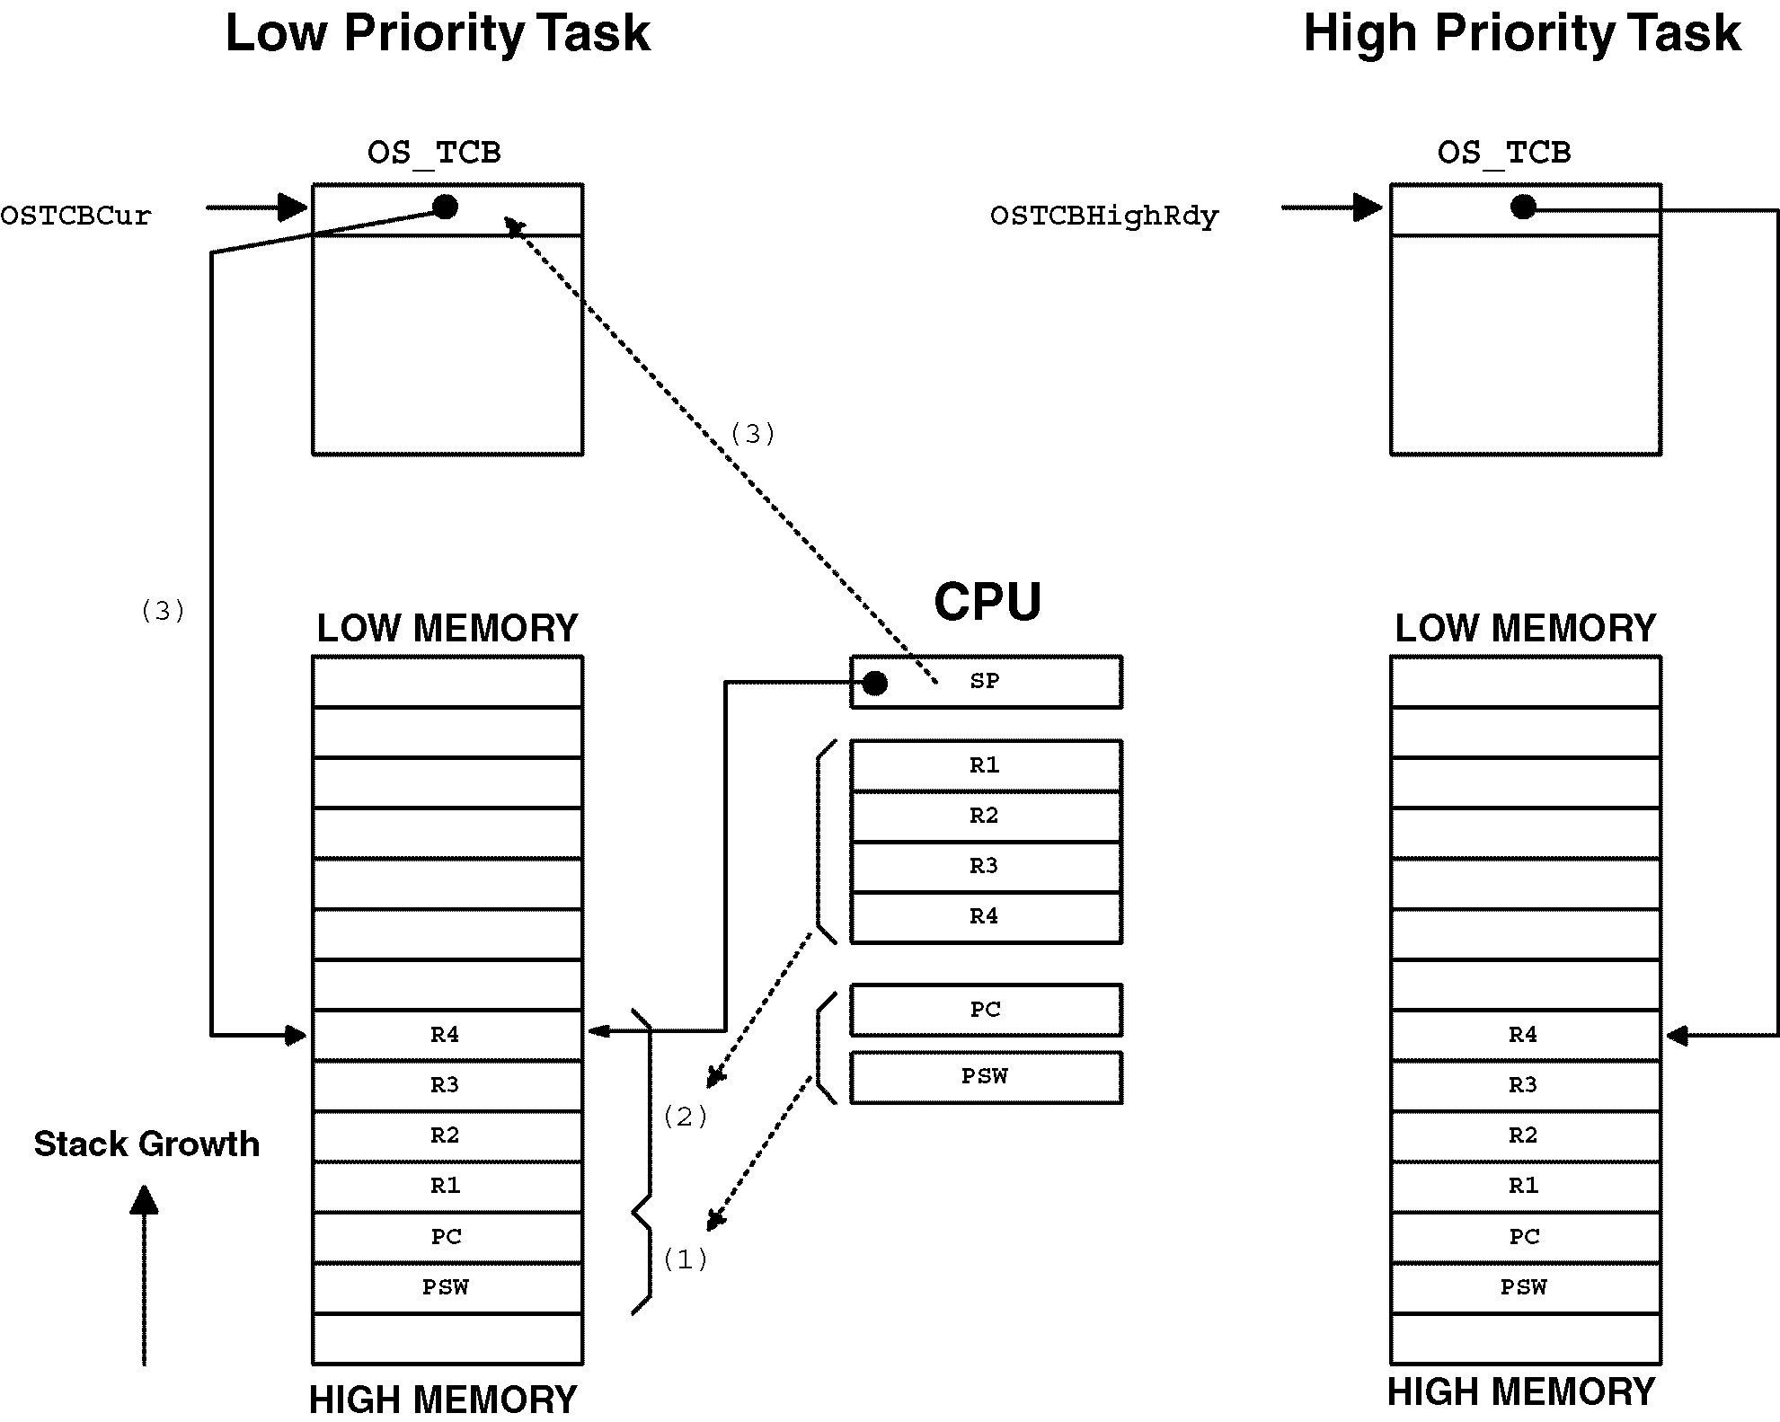
Task Scheduling
OS_TASK_SW()

Slide 92
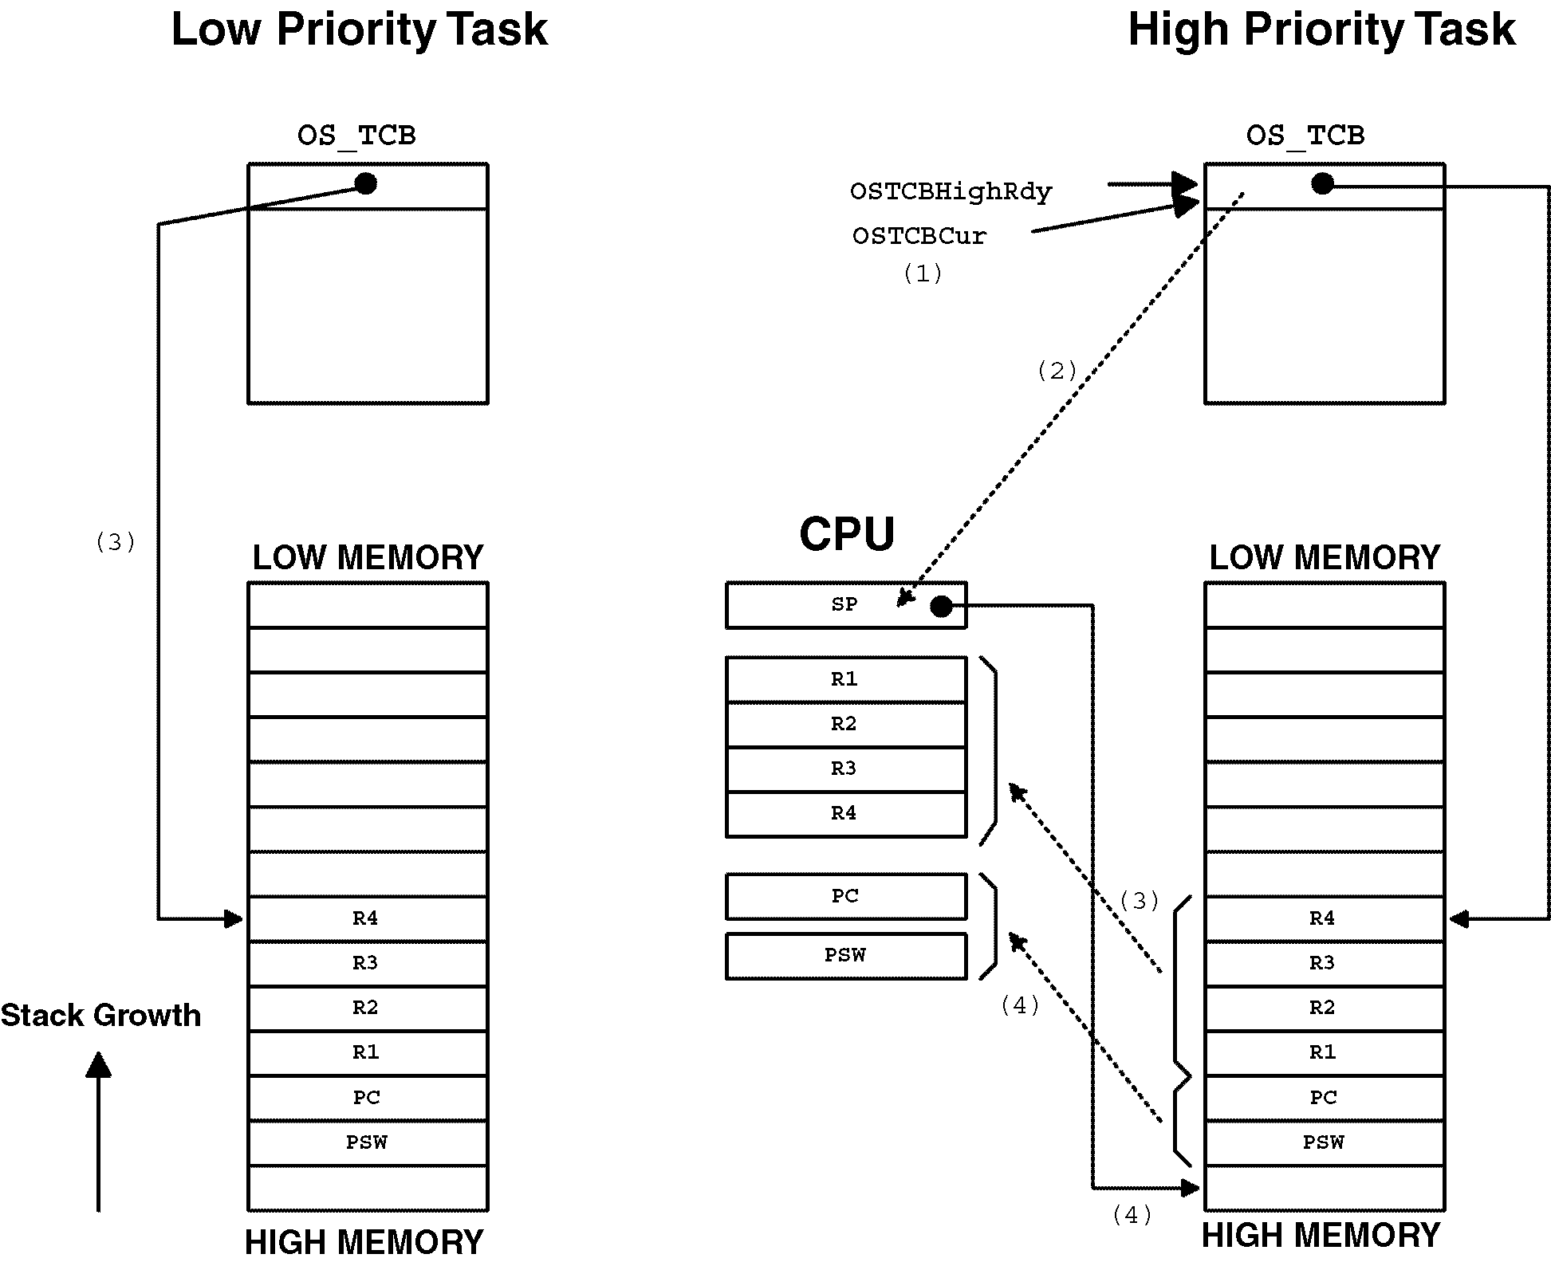
Task Scheduling
void OSCtxSw (void)
{
PUSH R1, R2, R3 and R4 onto the current stack;
OSTCBCur->OSTCBStkPtr = SP;
OSTCBCur = OSTCBHighRdy;
SP = OSTCBHighRdy->OSTCBStkPtr;
POP R4, R3, R2 and R1 from the new stack;
Execute a return from interrupt instruction;
}

Slide 93
Statistics Task
void main (void)
{
OSInit(); /* Initialize uC/OS-II (1)*/
/* Install uC/OS-II's context switch vector */
/* Create your startup task (for sake of discussion, TaskStart())(2)*/
OSStart(); /* Start multitasking (3)*/
}
void TaskStart (void *pdata)
{
/* Install and initialize ｵC/OS-II’s ticker (4)*/
OSStatInit(); /* Initialize statistics task (5)*/
/* Create your application task(s) */
for (;;) {
/* Code for TaskStart() goes here! */
}
}

Slide 94
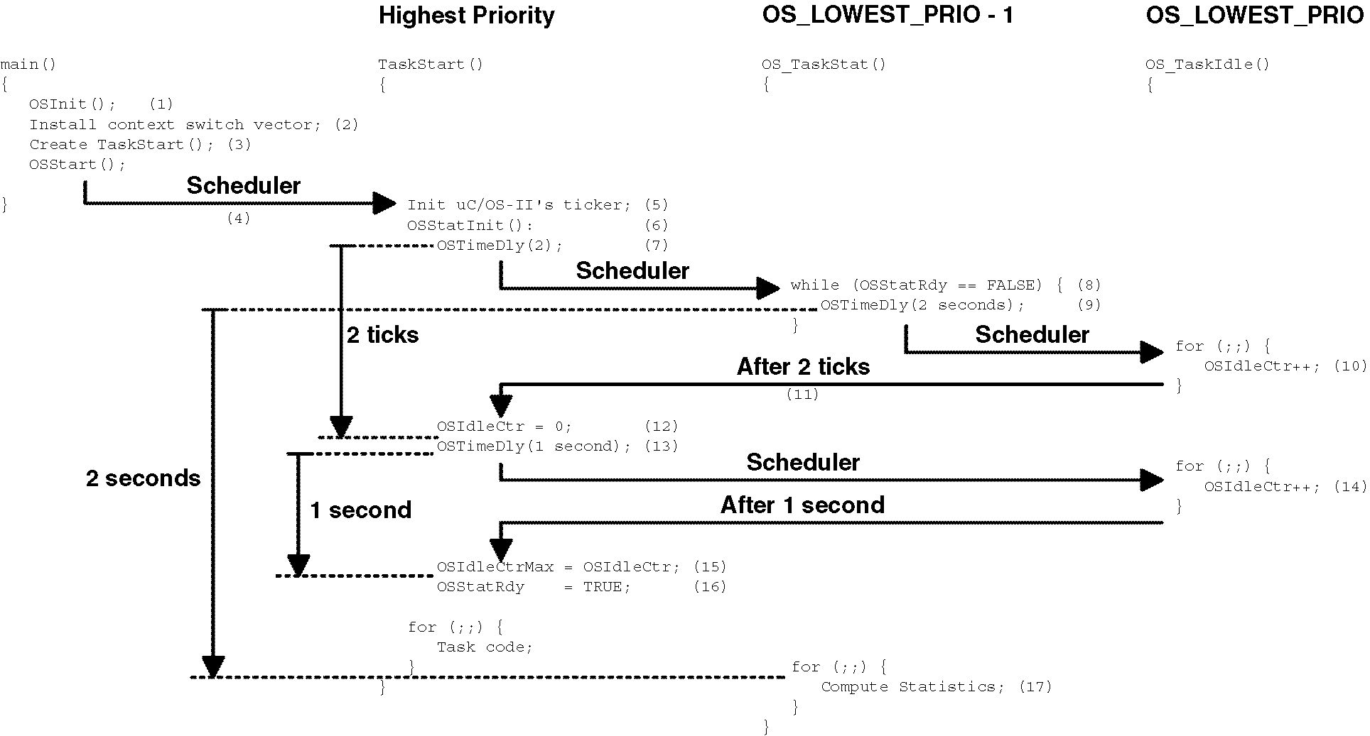
Statistics Task (continued..)

Slide 95
Interrupts Under uC/OS-II
YourISR:
Save all CPU registers; (1)
Call OSIntEnter() or, increment OSIntNesting directly; (2)
if (OSIntNesting == 1) { (3)
OSTCBCur->OSTCBStkPtr = SP; (4)
}
Clear interrupting device; (5)
Re-enable interrupts (optional) (6)
Execute user code to service ISR; (7)
Call OSIntExit(); (8)
Restore all CPU registers; (9)
Execute a return from interrupt instruction; (10)

Slide 96
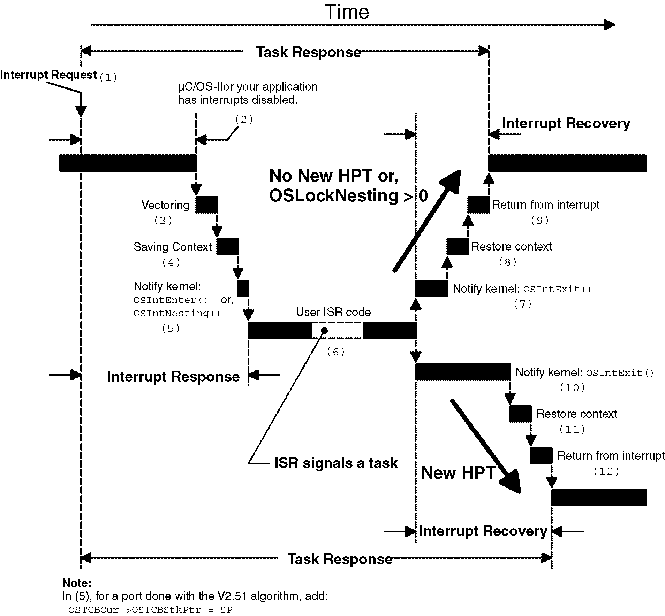
Interrupts Under uC/OS-II (continued)

Slide 97
Interrupts Under uC/OS-II (continued)
void OSIntEnter (void)
{
if (OSRunning == TRUE) {
if (OSIntNesting < 255) {
OSIntNesting++;
}
}
}
void OSIntExit (void)
{
#if OS_CRITICAL_METHOD == 3
OS_CPU_SR cpu_sr;
#endif
OS_ENTER_CRITICAL();
if (OSRunning == TRUE) {
if (OSIntNesting > 0) { (1)
OSIntNesting--;
}
if ((OSIntNesting == 0) && (OSLockNesting == 0)) {
OSIntExitY = OSUnMapTbl[OSRdyGrp]; (2)
OSPrioHighRdy = (INT8U)((OSIntExitY << 3)
+ OSUnMapTbl[OSRdyTbl[OSIntExitY]]);
if (OSPrioHighRdy != OSPrioCur) {
OSTCBHighRdy = OSTCBPrioTbl[OSPrioHighRdy];
OSCtxSwCtr++;
OSIntCtxSw(); (3)
}
}
}
OS_EXIT_CRITICAL();
}

Slide 98
Clock Tick
void main(void)
{
.
.
OSInit(); /* Initialize _C/OS-II */
.
.
/* Application initialization code ... */
/* ... Create at least one task by calling OSTaskCreate() */
.
.
Enable TICKER interrupts; /* DO NOT DO THIS HERE!!! */
.
.
OSStart(); /* Start multitasking */
}
void OSTickISR(void)
{
Save processor registers;
Call OSIntEnter() or increment OSIntNesting;
if (OSIntNesting == 1) {
OSTCBCur->OSTCBStkPtr = SP;
}
Call OSTimeTick();
Clear interrupting device;
Re-enable interrupts (optional);
Call OSIntExit();
Restore processor registers;
Execute a return from interrupt instruction;
}

Slide 99
Clock Tick (continued)
void OSTimeTick (void)
{
#if OS_CRITICAL_METHOD == 3
OS_CPU_SR cpu_sr;
#endif
OS_TCB *ptcb;
OSTimeTickHook(); (1)
#if OS_TIME_GET_SET_EN > 0
OS_ENTER_CRITICAL();
OSTime++; (2)
OS_EXIT_CRITICAL();
#endif
if (OSRunning == TRUE) {
ptcb = OSTCBList; (3)
while (ptcb->OSTCBPrio != OS_IDLE_PRIO) { (4)
OS_ENTER_CRITICAL();
if (ptcb->OSTCBDly != 0) {
if (--ptcb->OSTCBDly == 0) {
if ((ptcb->OSTCBStat & OS_STAT_SUSPEND) == 0x00) { (5)
OSRdyGrp |= ptcb->OSTCBBitY; (6)
OSRdyTbl[ptcb->OSTCBY] |= ptcb->OSTCBBitX;
} else {
ptcb->OSTCBDly = 1;
}
}
}
ptcb = ptcb->OSTCBNext;
OS_EXIT_CRITICAL();
}
}
}

Slide 100
Clock Tick (continued)
void TickTask (void *pdata)
{
pdata = pdata;
for (;;) {
OSMboxPend(...); /* Wait for signal from Tick ISR */
OSTimeTick();
OS_Sched();
}
}
void OSTickISR(void)
{
Save processor registers;
Call OSIntEnter() or increment OSIntNesting;
if (OSIntNesting == 1) {
OSTCBCur->OSTCBStkPtr = SP;
}
Post a 'dummy' message (e.g. (void *)1) to the tick mailbox;
Call OSIntExit();
Restore processor registers;
Execute a return from interrupt instruction;
}

Slide 101
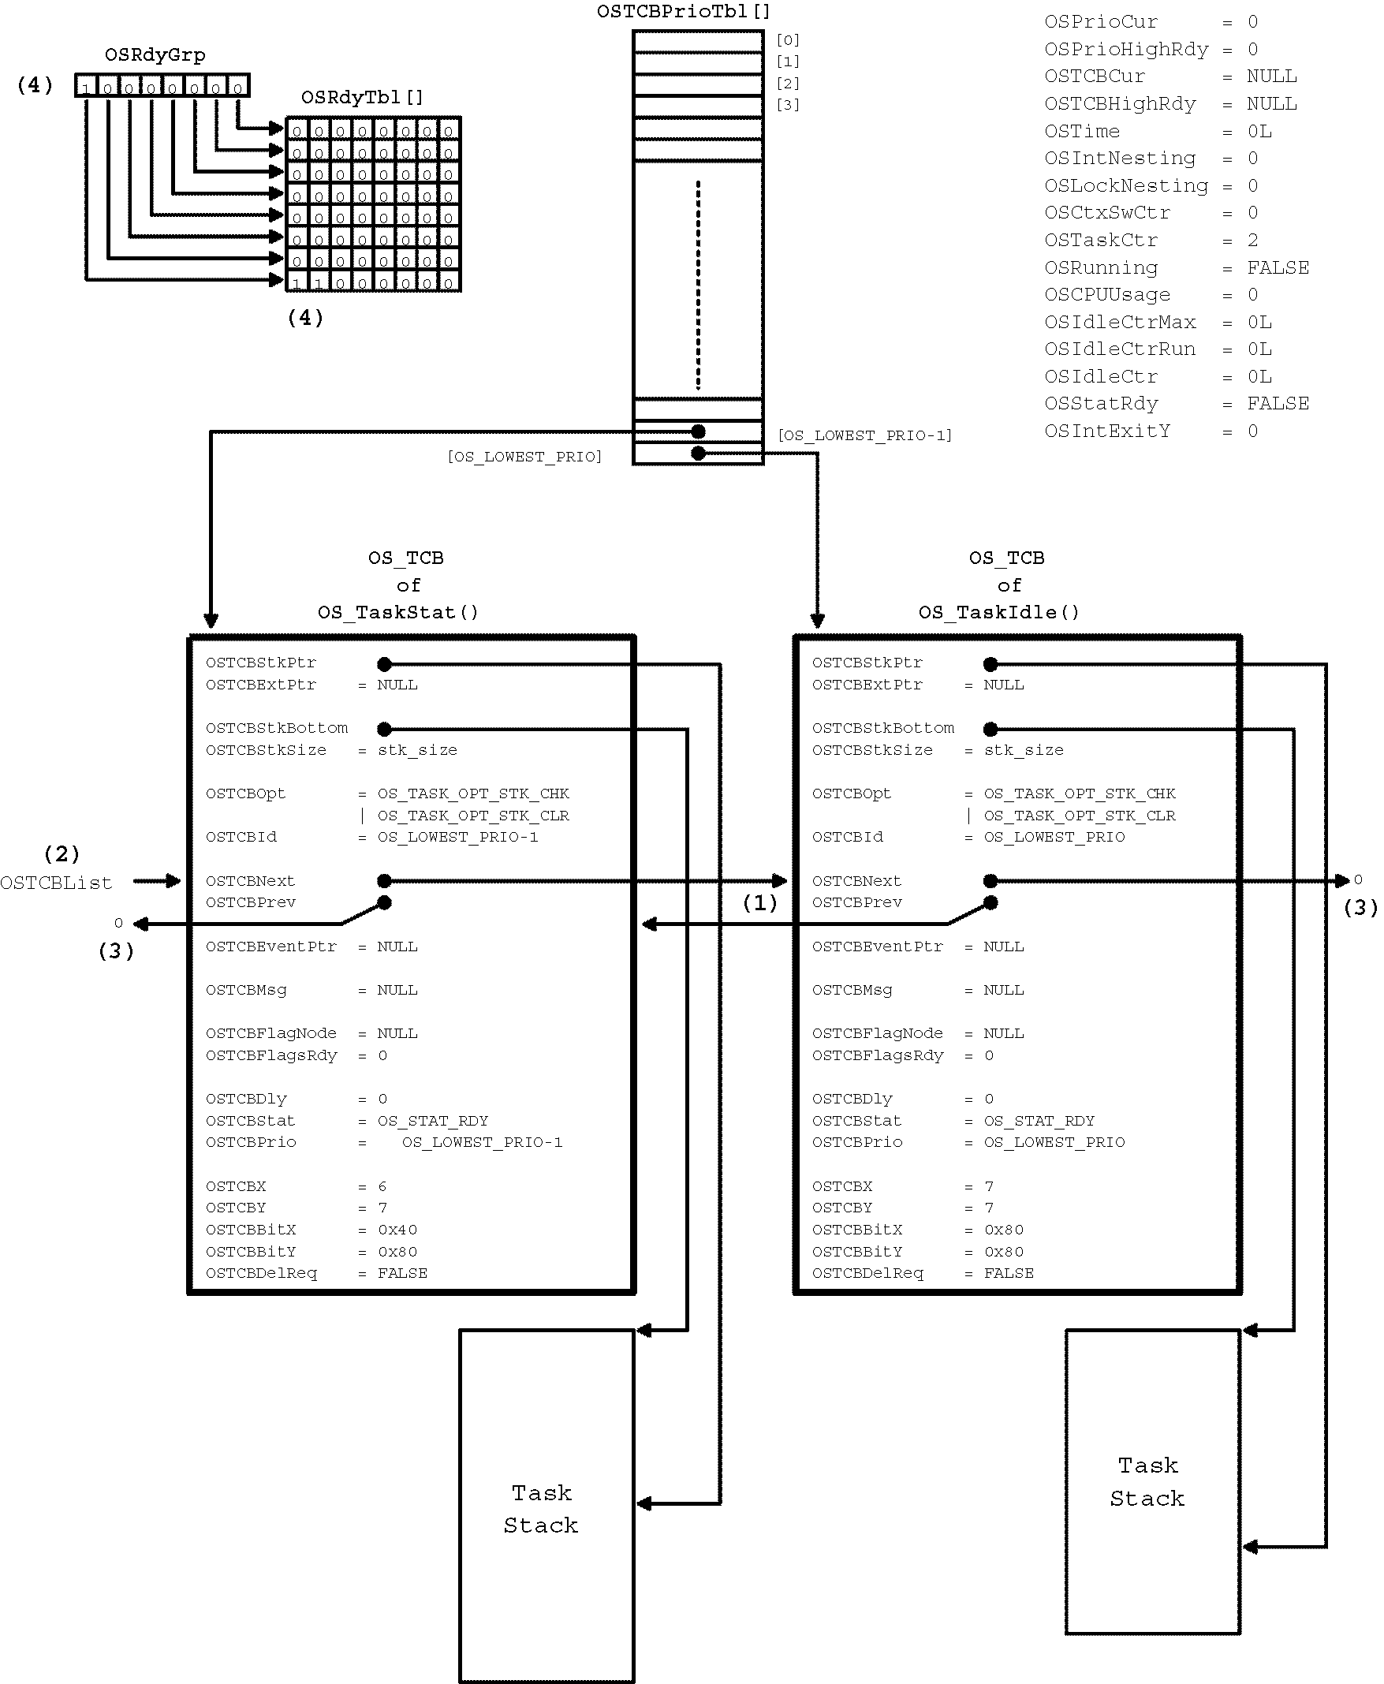
uC/OS-II Initialization

Slide 102
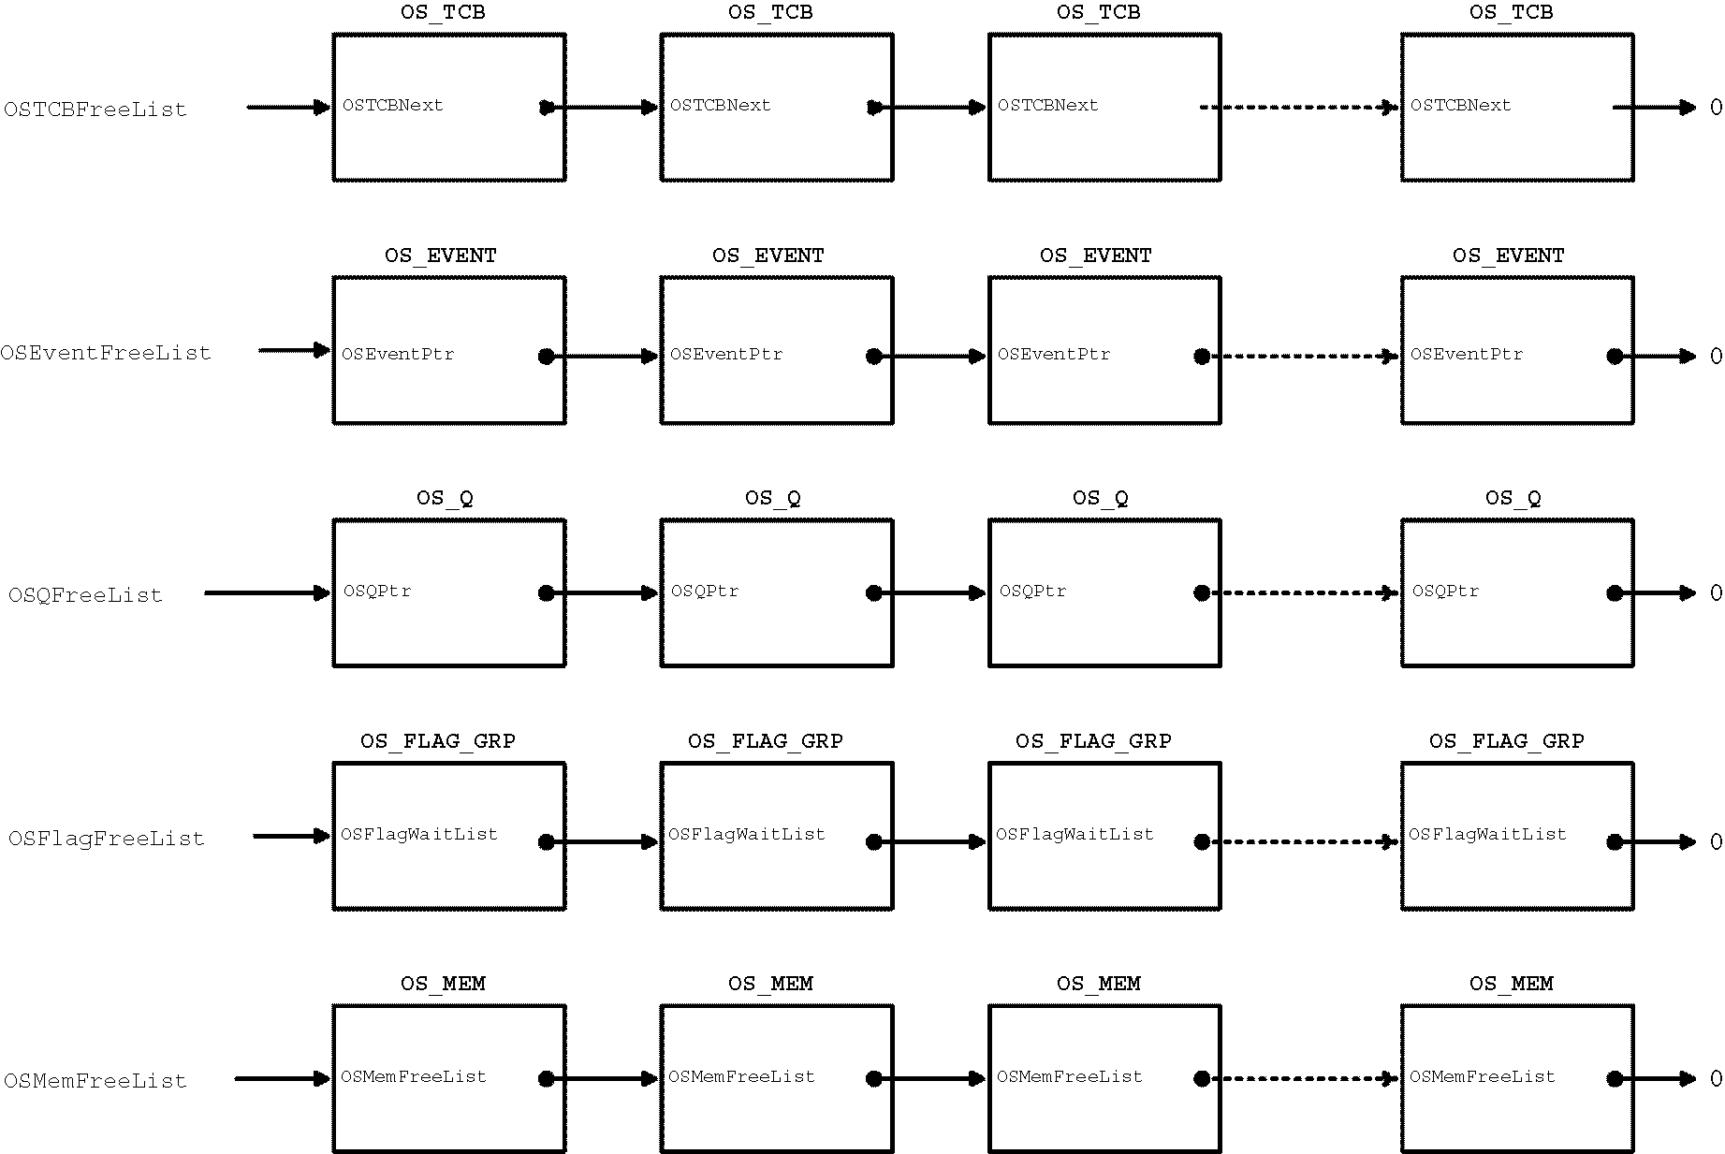
uC/OS-II Initialization (continued)

Slide 103
Starting uC/OS-II
void main (void)
{
OSInit(); /* Initialize uC/OS-II */
.
.
Create at least 1 task using either OSTaskCreate() or OSTaskCreateExt();
.
.
OSStart(); /* Start multitasking! OSStart() will not return */
}
void OSStart (void)
{
INT8U y;
INT8U x;
if (OSRunning == FALSE) {
y = OSUnMapTbl[OSRdyGrp];
x = OSUnMapTbl[OSRdyTbl[y]];
OSPrioHighRdy = (INT8U)((y << 3) + x);
OSPrioCur = OSPrioHighRdy;
OSTCBHighRdy = OSTCBPrioTbl[OSPrioHighRdy]; (1)
OSTCBCur = OSTCBHighRdy;
OSStartHighRdy(); (2)
}
}

Slide 104
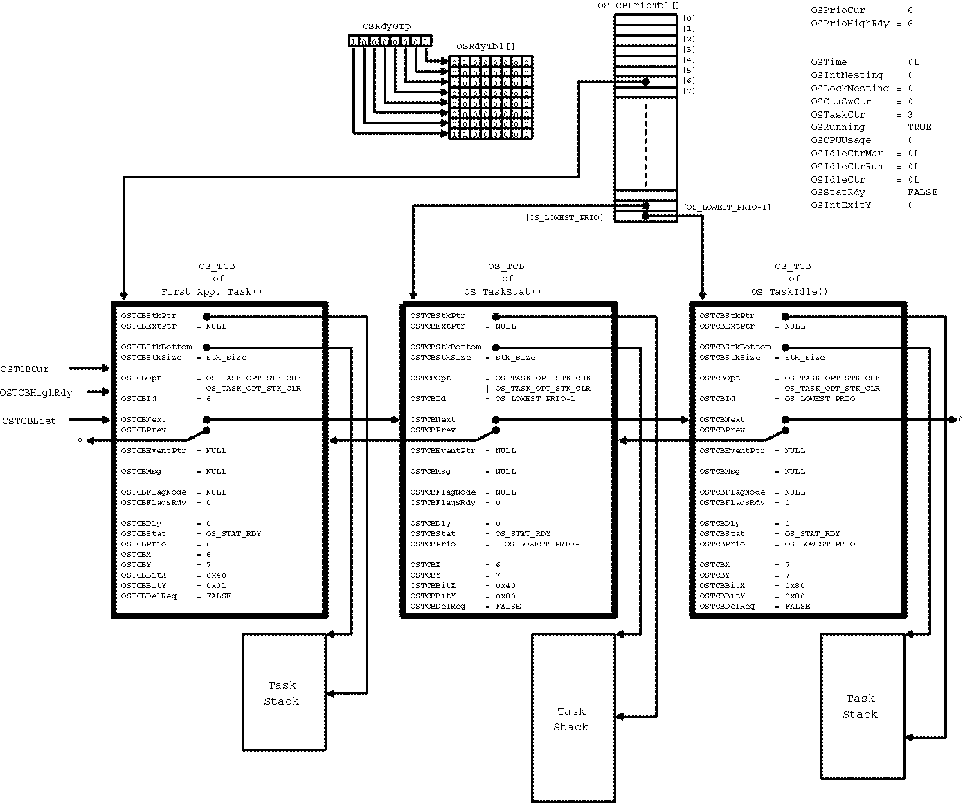
Starting uC/OS-II (continued)

Slide 105
Task Management
void YourTask (void *pdata)
{
for (;;) {
/* USER CODE */
Call one of uC/OS-II's services:
OSFlagPend();
OSMboxPend();
OSMutexPend();
OSQPend();
OSSemPend();
OSTaskSuspend(OS_PRIO_SELF);
OSTimeDly();
OSTimeDlyHMSM();
/* USER CODE */
}
}
Or
void YourTask (void *pdata)
{
/* USER CODE */
OSTaskDel(OS_PRIO_SELF);
}

Slide 106
Creating a Task, OSTaskCreate()
INT8U OSTaskCreate (void (*task)(void *pd), void *pdata, OS_STK *ptos, INT8U prio)
{
#if OS_CRITICAL_METHOD == 3
OS_CPU_SR cpu_sr;
#endif
void *psp;
INT8U err;
#if OS_ARG_CHK_EN > 0
if (prio > OS_LOWEST_PRIO) { (1)
return (OS_PRIO_INVALID);
}
#endif
OS_ENTER_CRITICAL();
if (OSTCBPrioTbl[prio] == (OS_TCB *)0) { (2)
OSTCBPrioTbl[prio] = (OS_TCB *)1; (3)
OS_EXIT_CRITICAL(); (4)
psp = (void *)OSTaskStkInit(task, pdata, ptos, 0); (5)
err = OS_TCBInit(prio, psp, (void *)0, 0, 0, (void *)0, 0); (6)
if (err == OS_NO_ERR) { (7)
OS_ENTER_CRITICAL();
OSTaskCtr++; (8)
OS_EXIT_CRITICAL();
if (OSRunning == TRUE) { (9)
OS_Sched(); (10)
}
} else {
OS_ENTER_CRITICAL();
OSTCBPrioTbl[prio] = (OS_TCB *)0; (11)
OS_EXIT_CRITICAL();
}
return (err);
OS_EXIT_CRITICAL();
return (OS_PRIO_EXIST);
}

Slide 107
Creating a Task, OSTaskCreateExt()
INT8U OSTaskCreateExt (void (*task)(void *pd),
void *pdata,
OS_STK *ptos,
INT8U prio,
INT16U id,
OS_STK *pbos,
INT32U stk_size,
void *pext,
INT16U opt)
{
#if OS_CRITICAL_METHOD == 3
OS_CPU_SR cpu_sr;
#endif
OS_STK *psp;
INT8U err;
#if OS_ARG_CHK_EN > 0
if (prio > OS_LOWEST_PRIO) { (1)
return (OS_PRIO_INVALID);
}
#endif
OS_ENTER_CRITICAL();
if (OSTCBPrioTbl[prio] == (OS_TCB *)0) { (2)
OSTCBPrioTbl[prio] = (OS_TCB *)1; (3)
OS_EXIT_CRITICAL(); (4)

Slide 108
OSTaskCreateExt(), continued..
if (((opt & OS_TASK_OPT_STK_CHK) != 0x0000) || (5)
((opt & OS_TASK_OPT_STK_CLR) != 0x0000)) {
#if OS_STK_GROWTH == 1
(void)memset(pbos, 0, stk_size * sizeof(OS_STK));
#else
(void)memset(ptos, 0, stk_size * sizeof(OS_STK));
#endif
}
psp = (OS_STK *)OSTaskStkInit(task, pdata, ptos, opt); (6)
err = OS_TCBInit(prio, psp, pbos, id, stk_size, pext, opt); (7)
if (err == OS_NO_ERR) { (8)
OS_ENTER_CRITICAL(); (9)
OSTaskCtr++;
OS_EXIT_CRITICAL();
if (OSRunning == TRUE) { (10)
OS_Sched(); (11)
}
} else {
OS_ENTER_CRITICAL();
OSTCBPrioTbl[prio] = (OS_TCB *)0;
OS_EXIT_CRITICAL();
}
return (err);
}
OS_EXIT_CRITICAL();
return (OS_PRIO_EXIST);
}

Slide 109
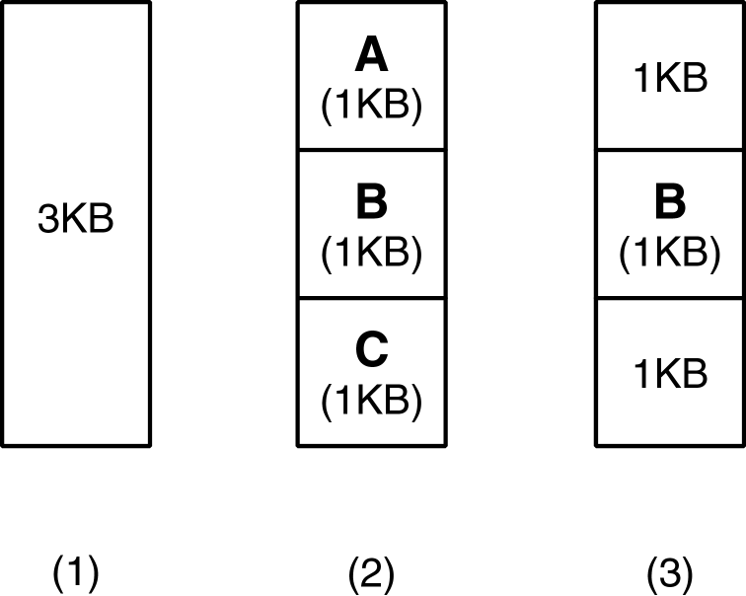
Fragmentation

Slide 110
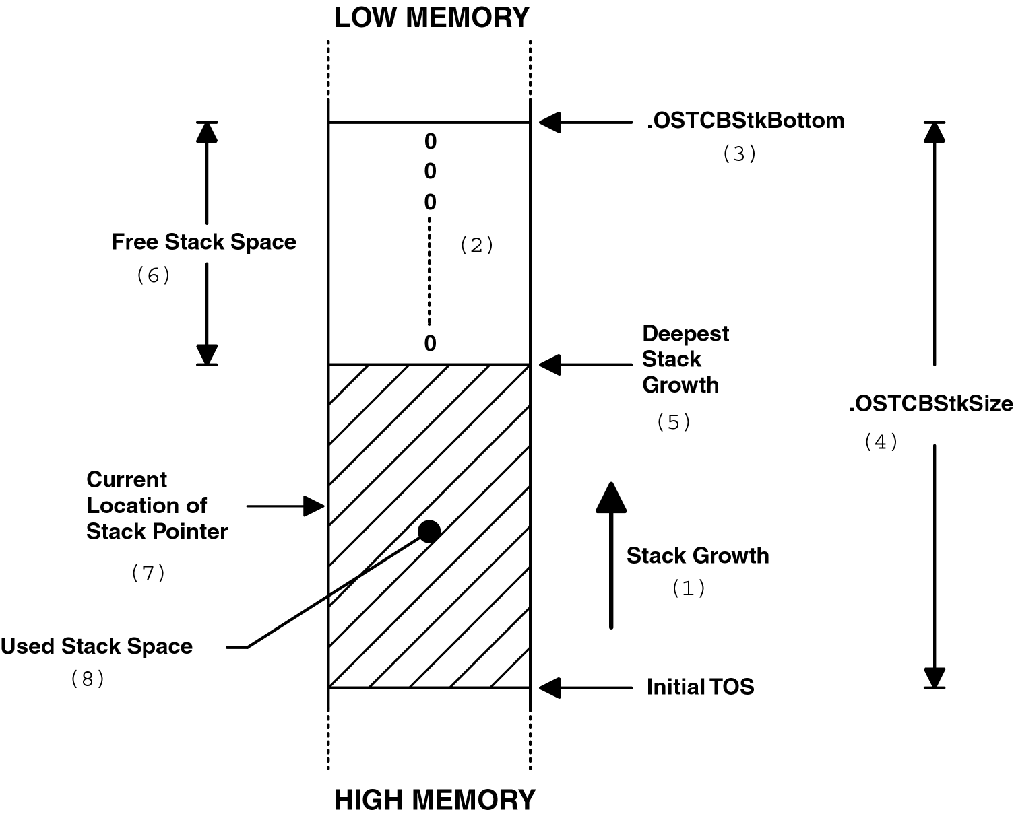
Stack checking

Slide 111
Stack checking function
INT8U OSTaskStkChk (INT8U prio, OS_STK_DATA *pdata)
{
#if OS_CRITICAL_METHOD == 3
OS_CPU_SR cpu_sr;
#endif
OS_TCB *ptcb;
OS_STK *pchk;
INT32U free;
INT32U size;
#if OS_ARG_CHK_EN > 0
if (prio > OS_LOWEST_PRIO && prio != OS_PRIO_SELF) { (1)
return (OS_PRIO_INVALID);
}
#endif
pdata->OSFree = 0;
pdata->OSUsed = 0;
OS_ENTER_CRITICAL();
if (prio == OS_PRIO_SELF) { (2)
prio = OSTCBCur->OSTCBPrio;
}
ptcb = OSTCBPrioTbl[prio];
if (ptcb == (OS_TCB *)0) { (3)
OS_EXIT_CRITICAL();
return (OS_TASK_NOT_EXIST);
}

Slide 112
Stack checking function, continued..
if ((ptcb->OSTCBOpt & OS_TASK_OPT_STK_CHK) == 0) { (4)
OS_EXIT_CRITICAL();
return (OS_TASK_OPT_ERR);
}
free = 0; (5)
size = ptcb->OSTCBStkSize;
pchk = ptcb->OSTCBStkBottom;
OS_EXIT_CRITICAL();
#if OS_STK_GROWTH == 1
while (*pchk++ == (OS_STK)0) {
free++;
}
#else
while (*pchk-- == (OS_STK)0) {
free++;
}
#endif
pdata->OSFree = free * sizeof(OS_STK); (6)
pdata->OSUsed = (size - free) * sizeof(OS_STK);
return (OS_NO_ERR);
}

Slide 113
Deleting a Task
INT8U OSTaskDel (INT8U prio)
{
#if OS_CRITICAL_METHOD == 3
OS_CPU_SR cpu_sr;
#endif
#if OS_EVENT_EN > 0
OS_EVENT *pevent;
#endif
#if (OS_VERSION >= 251) && (OS_FLAG_EN > 0) && (OS_MAX_FLAGS > 0)
OS_FLAG_NODE *pnode;
#endif
OS_TCB *ptcb;
BOOLEAN self;
if (OSIntNesting > 0) { (1)
return (OS_TASK_DEL_ISR);
}
#if OS_ARG_CHK_EN > 0
if (prio == OS_IDLE_PRIO) { (2)
return (OS_TASK_DEL_IDLE);
}
if (prio >= OS_LOWEST_PRIO && prio != OS_PRIO_SELF) { (3)
return (OS_PRIO_INVALID);
}
#endif
OS_ENTER_CRITICAL();

Slide 114
Deleting a Task, continued..
if (prio == OS_PRIO_SELF) { (4)
prio = OSTCBCur->OSTCBPrio;
}
ptcb = OSTCBPrioTbl[prio];
if (ptcb != (OS_TCB *)0) { (5)
if ((OSRdyTbl[ptcb->OSTCBY] &= ~ptcb->OSTCBBitX) == 0x00) { (6)
OSRdyGrp &= ~ptcb->OSTCBBitY;
}
#if OS_EVENT_EN > 0
pevent = ptcb->OSTCBEventPtr; (7)
if (pevent != (OS_EVENT *)0) {
if ((pevent->OSEventTbl[ptcb->OSTCBY] &= ~ptcb->OSTCBBitX) == 0) {
pevent->OSEventGrp &= ~ptcb->OSTCBBitY;
}
}
#endif
#if (OS_VERSION >= 251) && (OS_FLAG_EN > 0) && (OS_MAX_FLAGS > 0)
pnode = ptcb->OSTCBFlagNode; (8)
if (pnode != (OS_FLAG_NODE *)0) {
OS_FlagUnlink(pnode);
}
#endif
ptcb->OSTCBDly = 0; (9)
ptcb->OSTCBStat = OS_STAT_RDY; (10)
if (OSLockNesting < 255) { (11)
OSLockNesting++;
}

Slide 115
Deleting a Task, continued..
OS_EXIT_CRITICAL(); (12)
OS_Dummy(); (13)
OS_ENTER_CRITICAL();
if (OSLockNesting > 0) { (14)
OSLockNesting--;
}
OSTaskDelHook(ptcb); (15)
OSTaskCtr--; (16)
OSTCBPrioTbl[prio] = (OS_TCB *)0; (17)
if (ptcb->OSTCBPrev == (OS_TCB *)0) { (18)
ptcb->OSTCBNext->OSTCBPrev = (OS_TCB *)0;
OSTCBList = ptcb->OSTCBNext;
} else {
ptcb->OSTCBPrev->OSTCBNext = ptcb->OSTCBNext;
ptcb->OSTCBNext->OSTCBPrev = ptcb->OSTCBPrev;
}
ptcb->OSTCBNext = OSTCBFreeList; (19)
OSTCBFreeList = ptcb;
OS_EXIT_CRITICAL();
OS_Sched(); (20)
return (OS_NO_ERR);
}
OS_EXIT_CRITICAL();
return (OS_TASK_DEL_ERR);
}

Slide 116
Requesting to Delete a Task
INT8U OSTaskDelReq (INT8U prio)
{
#if OS_CRITICAL_METHOD == 3
OS_CPU_SR cpu_sr;
#endif
BOOLEAN stat;
INT8U err;
OS_TCB *ptcb;
#if OS_ARG_CHK_EN > 0
if (prio == OS_IDLE_PRIO) { (1)
return (OS_TASK_DEL_IDLE);
}
if (prio >= OS_LOWEST_PRIO && prio != OS_PRIO_SELF) { (2)
return (OS_PRIO_INVALID);
}
#endif
if (prio == OS_PRIO_SELF) { (3)
OS_ENTER_CRITICAL();
stat = OSTCBCur->OSTCBDelReq;
OS_EXIT_CRITICAL();
return (stat);
}

Slide 117
Requesting to Delete a Task , continued..
OS_ENTER_CRITICAL();
ptcb = OSTCBPrioTbl[prio];
if (ptcb != (OS_TCB *)0) { (4)
ptcb->OSTCBDelReq = OS_TASK_DEL_REQ; (5)
err = OS_NO_ERR;
} else {
err = OS_TASK_NOT_EXIST; (6)
}
OS_EXIT_CRITICAL();
return (err);
}

Slide 118
Requesting to Delete a Task , continued..
OS_ENTER_CRITICAL();
ptcb = OSTCBPrioTbl[prio];
if (ptcb != (OS_TCB *)0) { (4)
ptcb->OSTCBDelReq = OS_TASK_DEL_REQ; (5)
err = OS_NO_ERR;
} else {
err = OS_TASK_NOT_EXIST; (6)
}
OS_EXIT_CRITICAL();
return (err);
}

Slide 119
Changing a Task’s Priority
INT8U OSTaskChangePrio (INT8U oldprio, INT8U newprio)
{
#if OS_CRITICAL_METHOD == 3
OS_CPU_SR cpu_sr;
#endif
#if OS_EVENT_EN > 0
OS_EVENT *pevent;
#endif
OS_TCB *ptcb;
INT8U x;
INT8U y;
INT8U bitx;
INT8U bity;
#if OS_ARG_CHK_EN > 0
if ((oldprio >= OS_LOWEST_PRIO && oldprio != OS_PRIO_SELF) || (1)
newprio >= OS_LOWEST_PRIO) {
return (OS_PRIO_INVALID);
}
#endif
OS_ENTER_CRITICAL();
if (OSTCBPrioTbl[newprio] != (OS_TCB *)0) { (2)
OS_EXIT_CRITICAL();
return (OS_PRIO_EXIST);
} else {
OSTCBPrioTbl[newprio] = (OS_TCB *)1; (3)
OS_EXIT_CRITICAL();
y = newprio >> 3; (4)
bity = OSMapTbl[y];
x = newprio & 0x07;
bitx = OSMapTbl[x];

Slide 120
Changing a Task’s Priority, continued..
OS_ENTER_CRITICAL();
if (oldprio == OS_PRIO_SELF) { (5)
oldprio = OSTCBCur->OSTCBPrio;
}
ptcb = OSTCBPrioTbl[oldprio];
if (ptcb != (OS_TCB *)0) { (6)
OSTCBPrioTbl[oldprio] = (OS_TCB *)0; (7)
if ((OSRdyTbl[ptcb->OSTCBY] & ptcb->OSTCBBitX) != 0x00) { (8)
if ((OSRdyTbl[ptcb->OSTCBY] &= ~ptcb->OSTCBBitX) == 0x00) { (9)
OSRdyGrp &= ~ptcb->OSTCBBitY;
}
OSRdyGrp |= bity; (10)
OSRdyTbl[y] |= bitx;
#if OS_EVENT_EN > 0
} else {
pevent = ptcb->OSTCBEventPtr;
if (pevent != (OS_EVENT *)0) { (11)
if ((pevent->OSEventTbl[ptcb->OSTCBY] &= ~ptcb->OSTCBBitX) == 0) {
pevent->OSEventGrp &= ~ptcb->OSTCBBitY;
}
pevent->OSEventGrp |= bity; (12)
pevent->OSEventTbl[y] |= bitx;
}
#endif
}
OSTCBPrioTbl[newprio] = ptcb; (13)
ptcb->OSTCBPrio = newprio; (14)
ptcb->OSTCBY = y; (15)
ptcb->OSTCBX = x;
ptcb->OSTCBBitY = bity;
ptcb->OSTCBBitX = bitx;
OS_EXIT_CRITICAL();

Slide 121
Changing a Task’s Priority, continued..
OS_Sched(); (16)
return (OS_NO_ERR);
} else {
OSTCBPrioTbl[newprio] = (OS_TCB *)0; (17)
OS_EXIT_CRITICAL();
return (OS_PRIO_ERR);
}
}
}

Slide 122
Suspending a Task
INT8U OSTaskSuspend (INT8U prio)
{
#if OS_CRITICAL_METHOD == 3
OS_CPU_SR cpu_sr;
#endif
BOOLEAN self;
OS_TCB *ptcb;
#if OS_ARG_CHK_EN > 0
if (prio == OS_IDLE_PRIO) { (1)
return (OS_TASK_SUSPEND_IDLE);
}
if (prio >= OS_LOWEST_PRIO && prio != OS_PRIO_SELF) { (2)
return (OS_PRIO_INVALID);
}
#endif
OS_ENTER_CRITICAL();
if (prio == OS_PRIO_SELF) { (3)
prio = OSTCBCur->OSTCBPrio;
self = TRUE;
} else if (prio == OSTCBCur->OSTCBPrio) { (4)
self = TRUE;
} else {
self = FALSE;
}

Slide 123
Suspending a Task, continued..
ptcb = OSTCBPrioTbl[prio]; (5)
if (ptcb == (OS_TCB *)0) {
OS_EXIT_CRITICAL();
return (OS_TASK_SUSPEND_PRIO);
}
if ((OSRdyTbl[ptcb->OSTCBY] &= ~ptcb->OSTCBBitX) == 0x00) { (6)
OSRdyGrp &= ~ptcb->OSTCBBitY;
}
ptcb->OSTCBStat |= OS_STAT_SUSPEND; (7)
OS_EXIT_CRITICAL();
if (self == TRUE) {
OS_Sched(); (8)
}
return (OS_NO_ERR);
}

Slide 124
Resuming a Task
INT8U OSTaskResume (INT8U prio)
{
#if OS_CRITICAL_METHOD == 3
OS_CPU_SR cpu_sr;
#endif
OS_TCB *ptcb;
#if OS_ARG_CHK_EN > 0
if (prio >= OS_LOWEST_PRIO) { (1)
return (OS_PRIO_INVALID);
}
#endif
OS_ENTER_CRITICAL();
ptcb = OSTCBPrioTbl[prio];
if (ptcb == (OS_TCB *)0) { (2)
OS_EXIT_CRITICAL();
return (OS_TASK_RESUME_PRIO);
}

Slide 125
Resuming a Task, continued..
if ((ptcb->OSTCBStat & OS_STAT_SUSPEND) != 0x00) { (3)
if (((ptcb->OSTCBStat &= ~OS_STAT_SUSPEND) == OS_STAT_RDY) && (4)
(ptcb->OSTCBDly == 0)) { (5)
OSRdyGrp |= ptcb->OSTCBBitY; (6)
OSRdyTbl[ptcb->OSTCBY] |= ptcb->OSTCBBitX;
OS_EXIT_CRITICAL();
OS_Sched(); (7)
} else {
OS_EXIT_CRITICAL();
}
return (OS_NO_ERR);
}
OS_EXIT_CRITICAL();
return (OS_TASK_NOT_SUSPENDED);
}

Slide 126
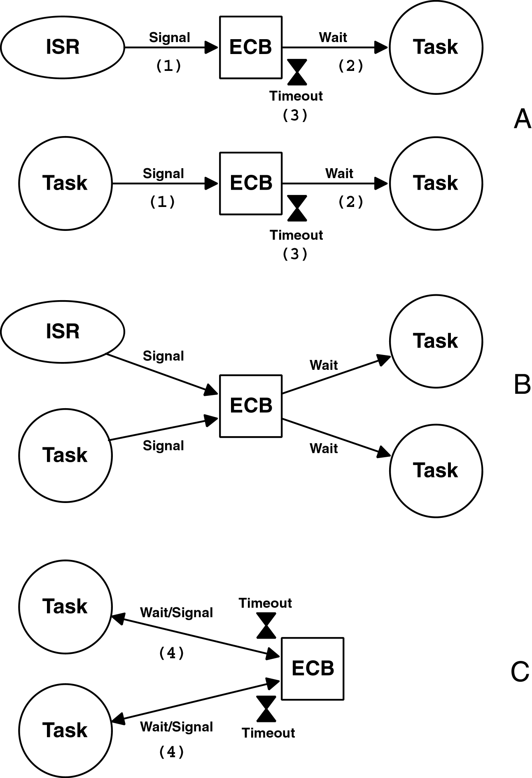
Use of Event Control Block

Slide 127
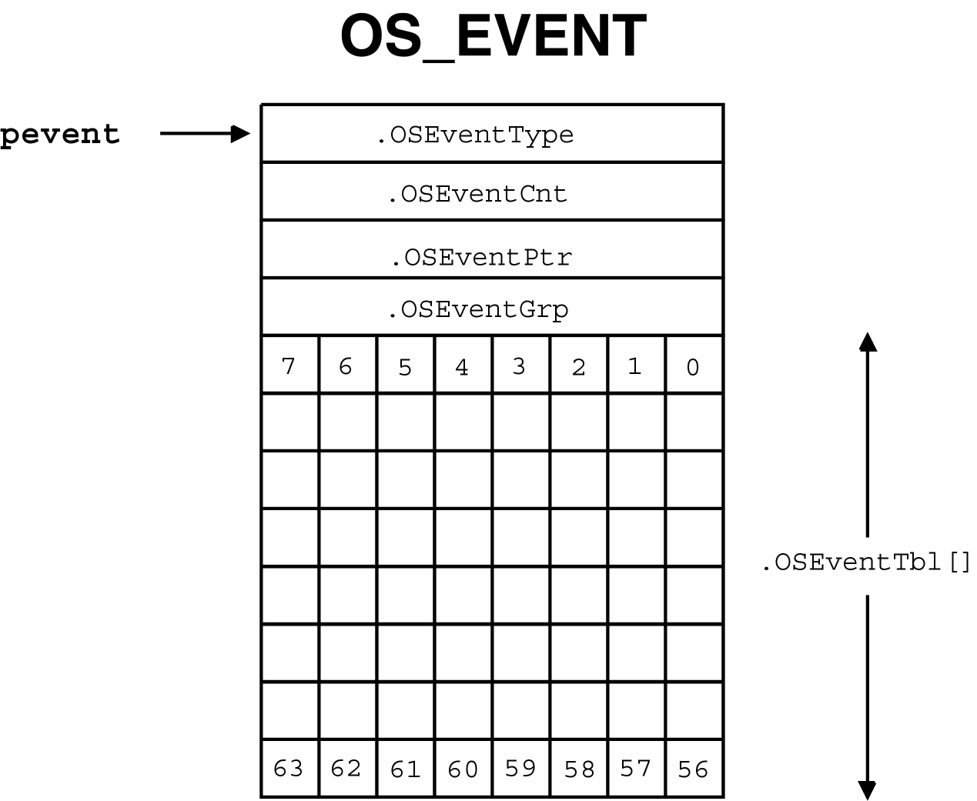
Event control block data structure
typedef struct {
INT8U OSEventType; /* Event type */
INT8U OSEventGrp; /* Group for wait list */
INT16U OSEventCnt; /* Count (when event is a semaphore) */
void *OSEventPtr; /* Ptr to message or queue structure */
INT8U OSEventTbl[OS_EVENT_TBL_SIZE]; /* Wait list for event to occur */
} OS_EVENT;

Slide 128
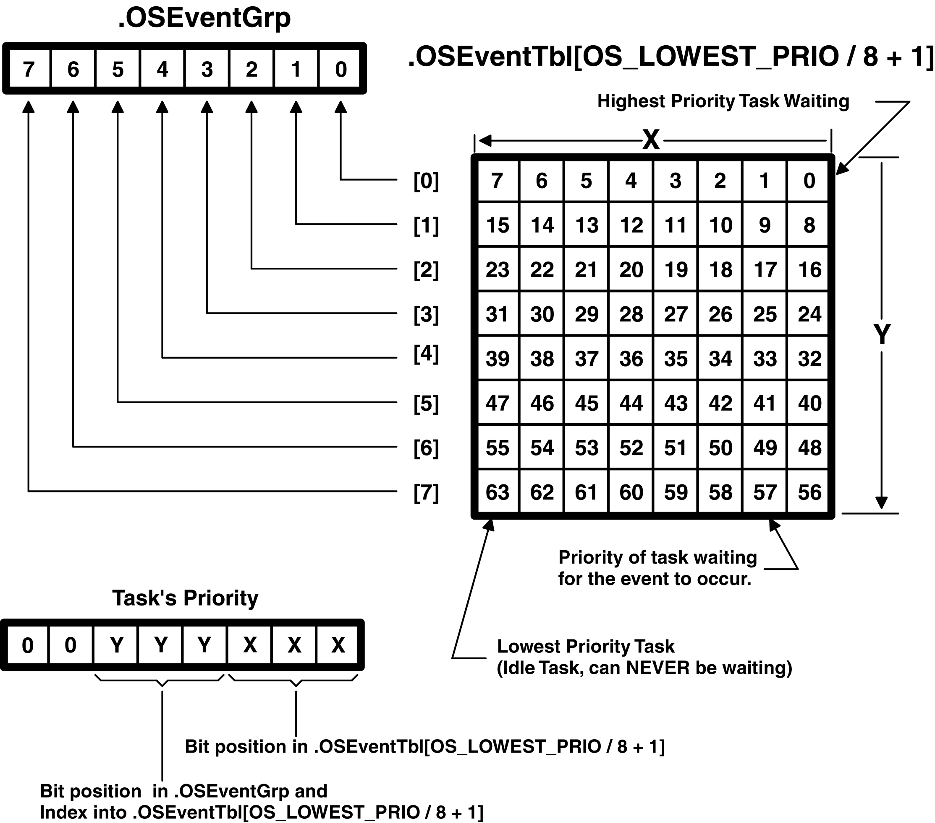
Wait List

Slide 129
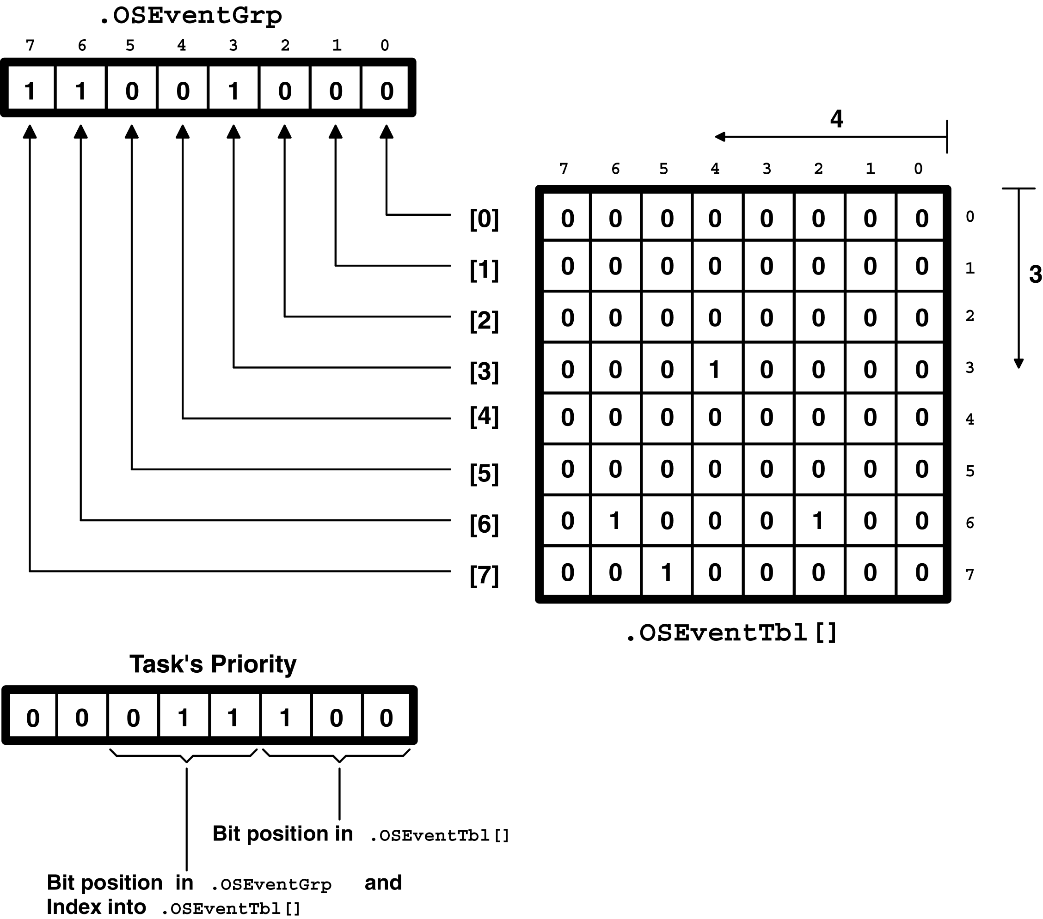
Wait List Example

Slide 130
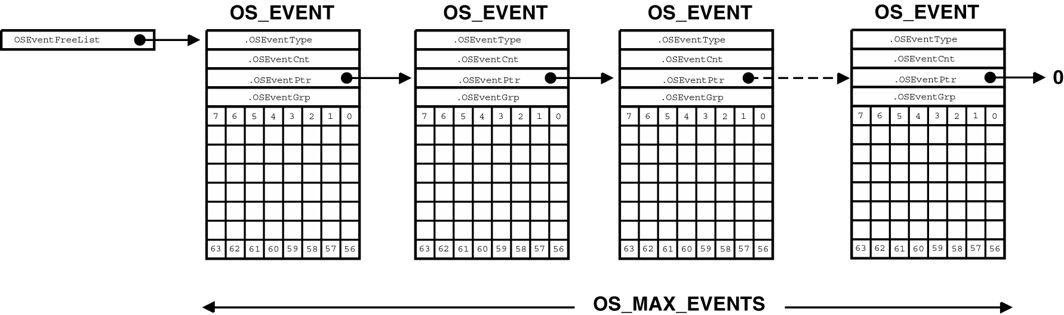
List of Free ECBs

Slide 131
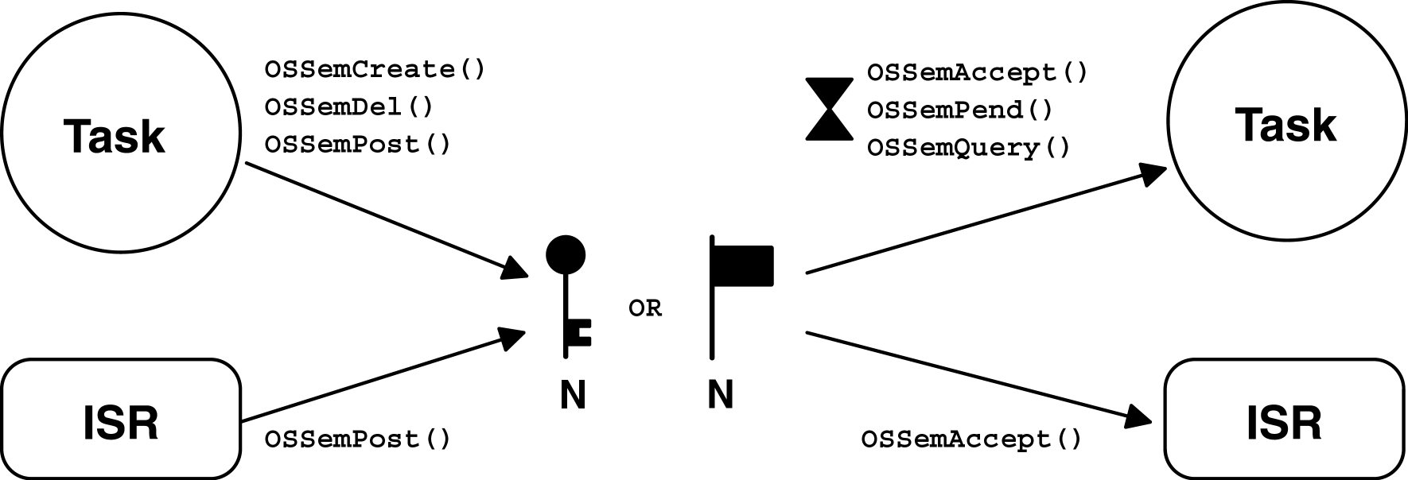
Relationships between tasks, ISRs, and a semaphore

Slide 132
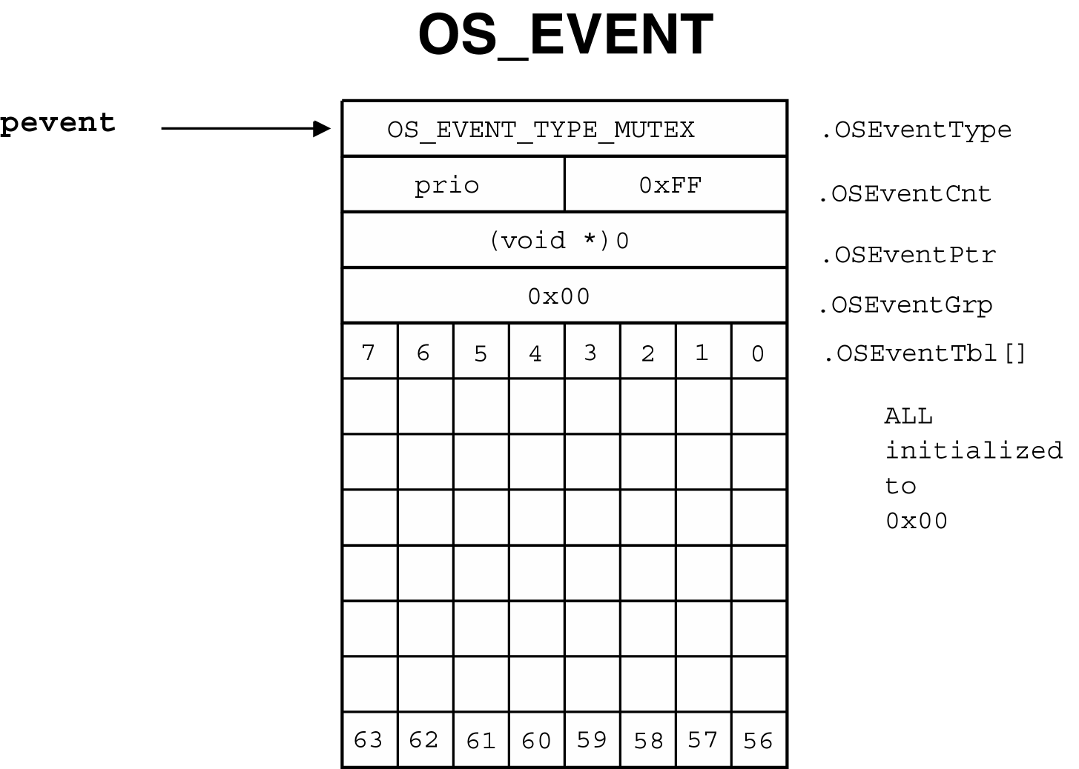
ECB just before OSSemCreate() returns

Slide 133
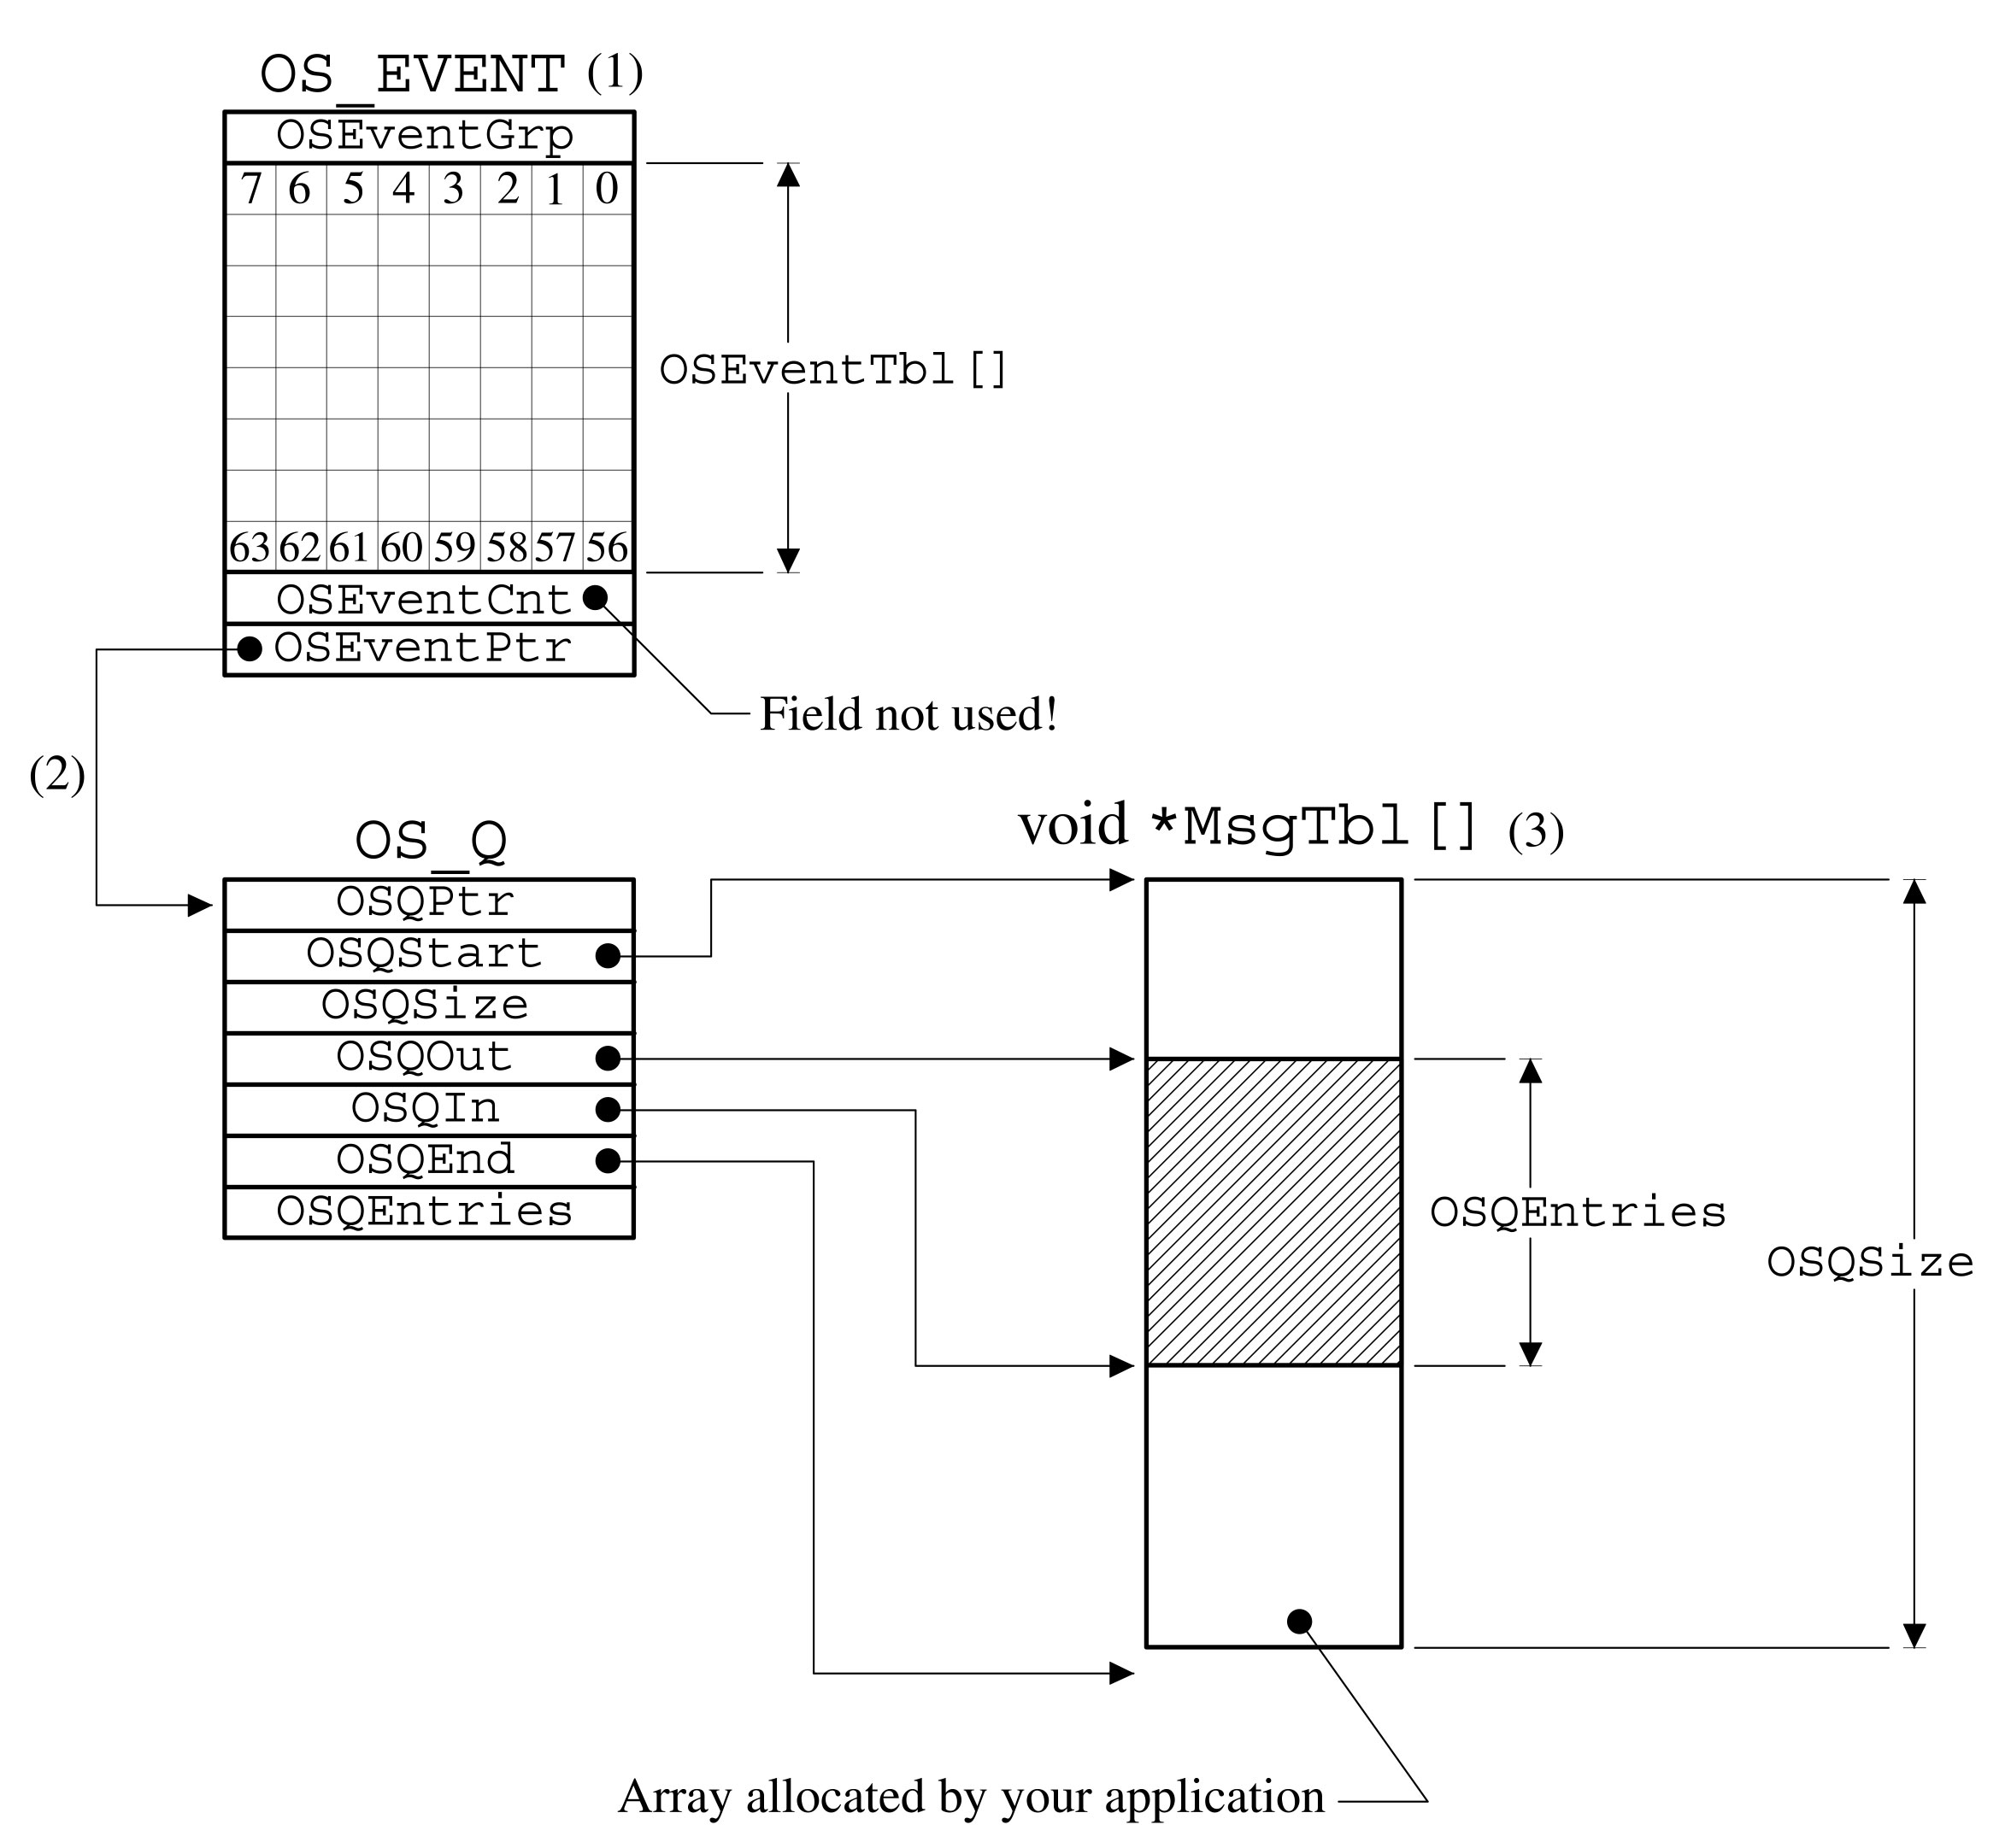
Message Queue Structure

Slide 134
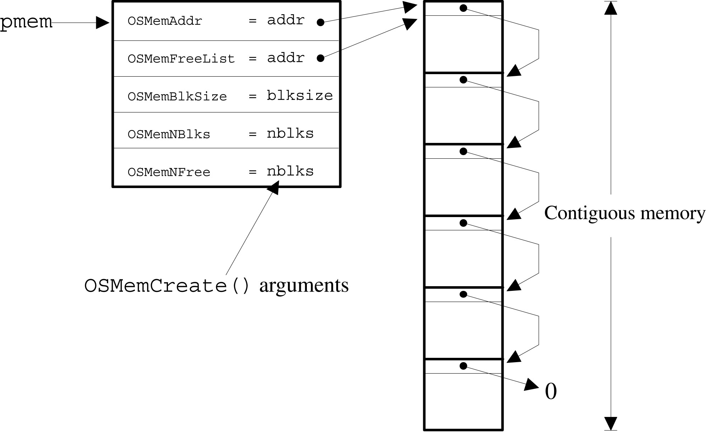
OSMemCreate()

Slide 135
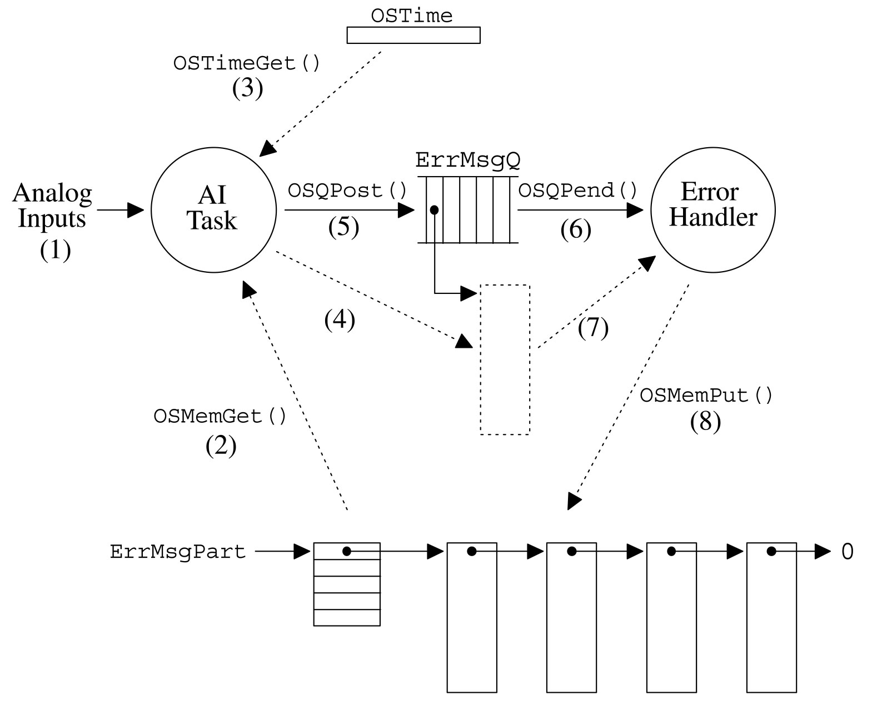
Dynamic Memory Allocation Example

Slide 136
Porting MicroC/OS-II
Requirements
  At least one timing source(internal or external) to generate regular interrupt for time slicing.
  Plenty of ROM and RAM for OS kernel and task contexts (TCB, stack..).
  C compiler that generates reentrant code.
  Interrupts can be disabled and enabled from C
  Instruction that move register’s contents to stack or from stack to registers.
Motorola 6805 doesn’t satisfy all the requirements

Slide 137
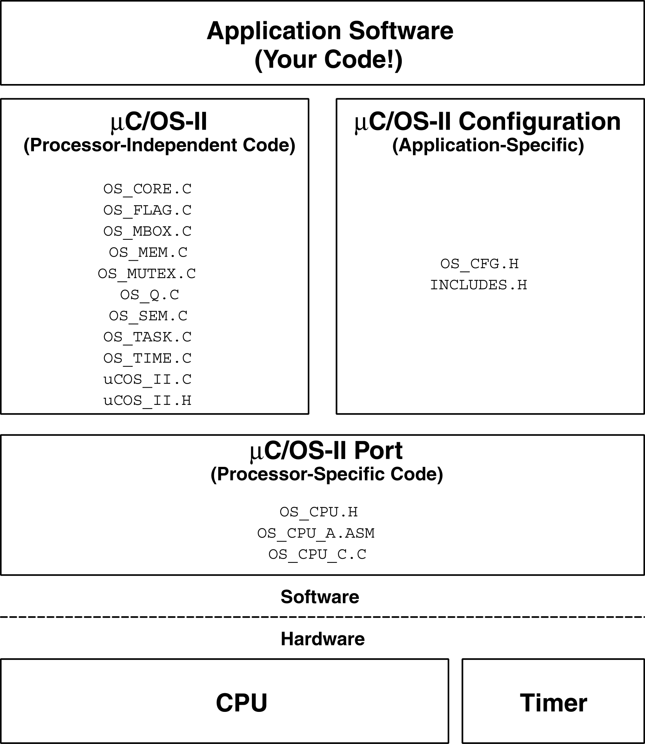
Porting MicroC/OS-II

Slide 138
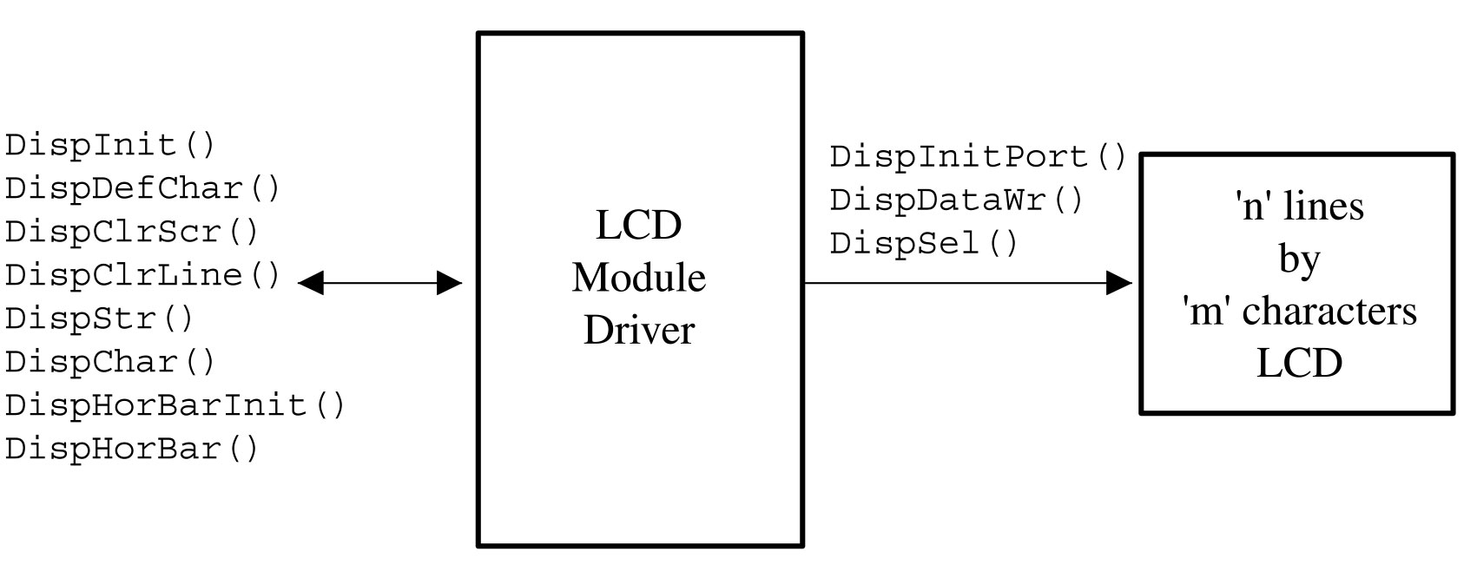
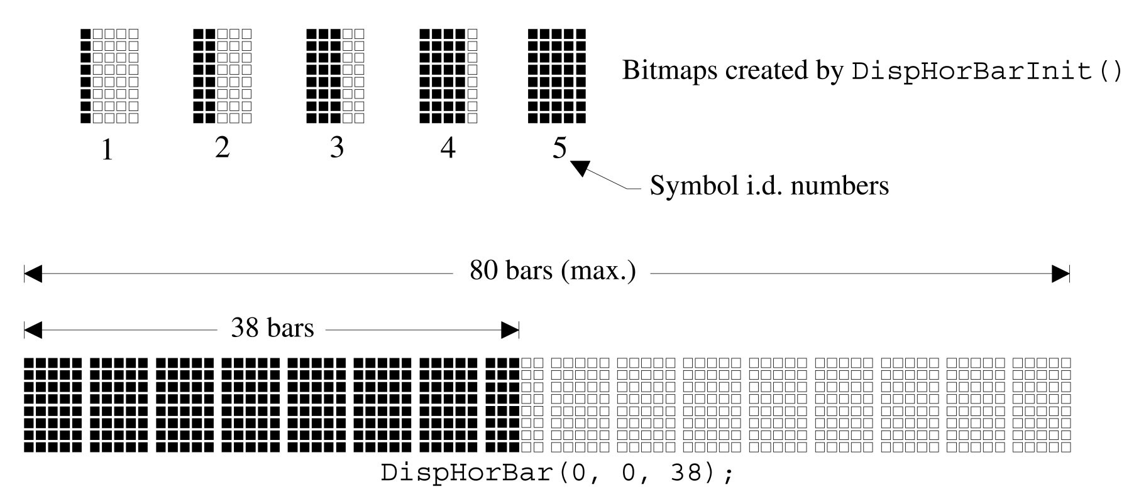
Character LCD Driver
Most simple device driver(Based on Hitachi HD44780)
  This uses only one direction control
  Encapsulated with mutual exclusion semaphore so that multiple tasks could avoid data corruption

Slide 139
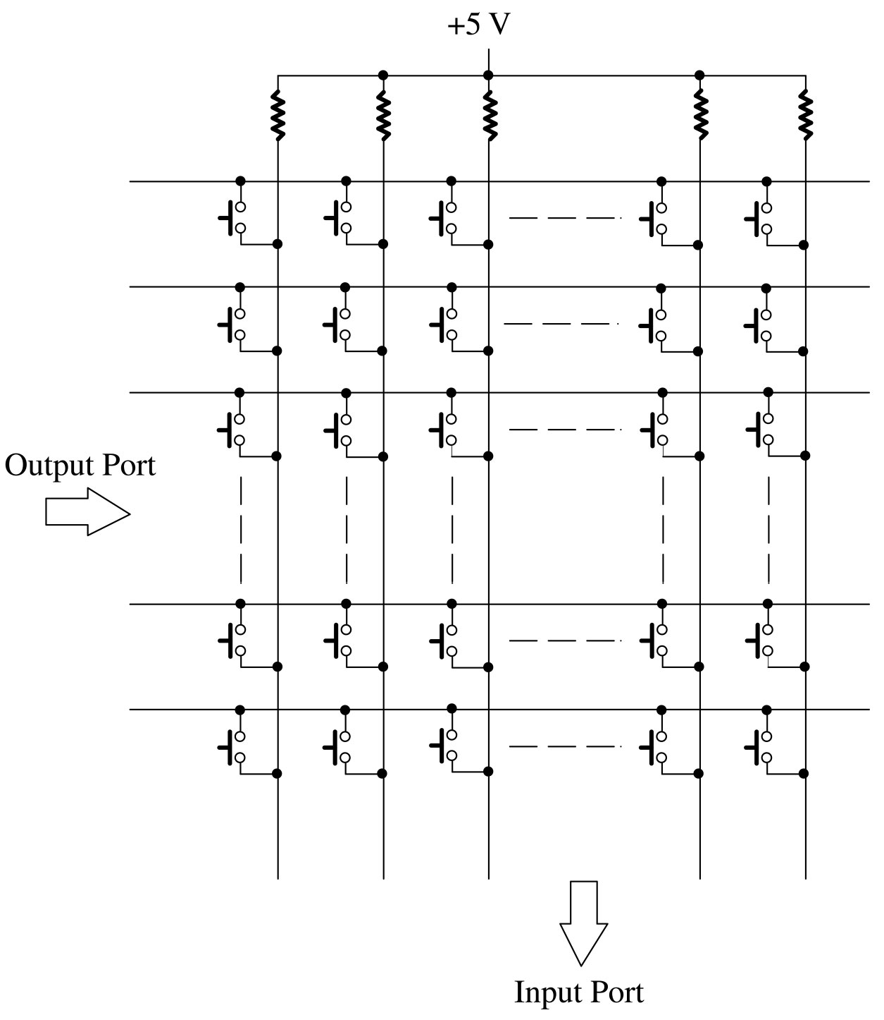
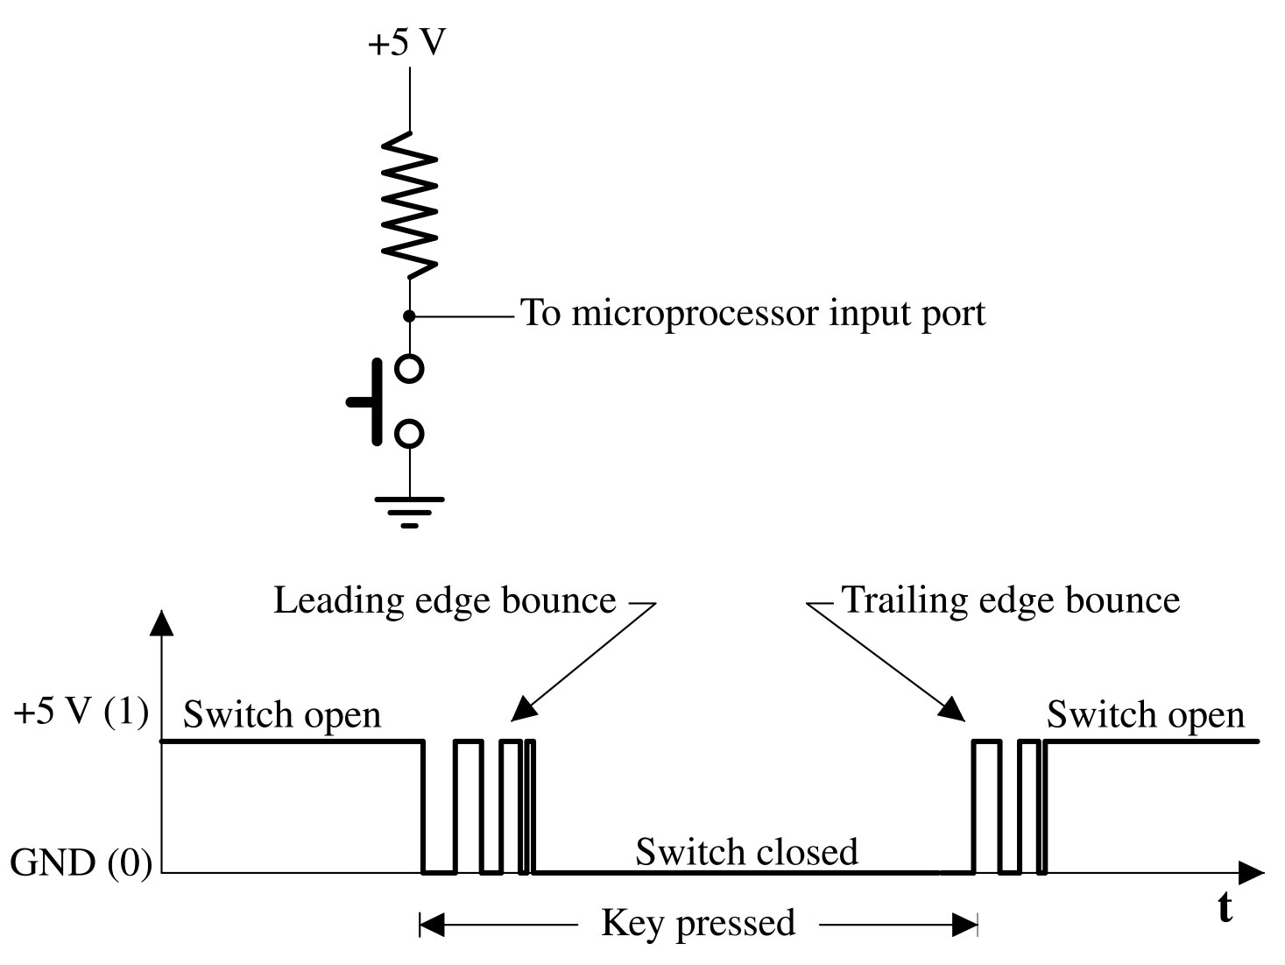
Keypad Driver
Based on regularly executing Key task
  Initialization routine automatically create key task.
  The task scans matrix key and debounces switch noises.
  When a key is pressed for predetermined time, task puts the key value into the buffer.
API allows other tasks to be blocked until key value is inserted to the buffer

Slide 140
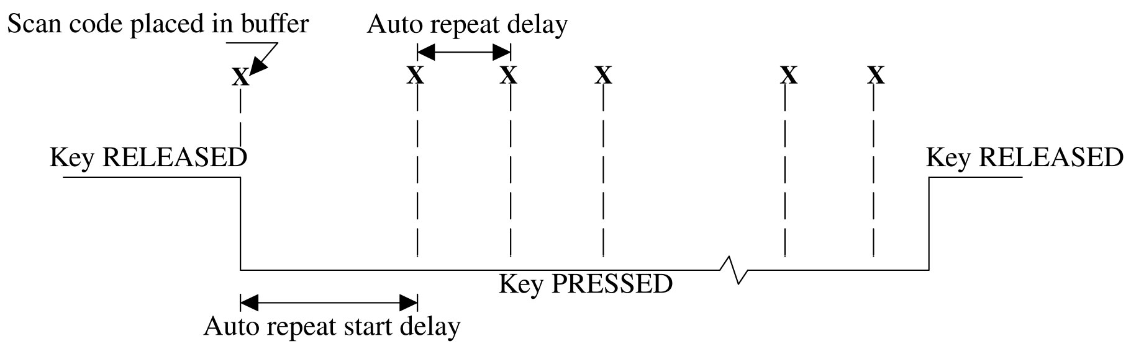
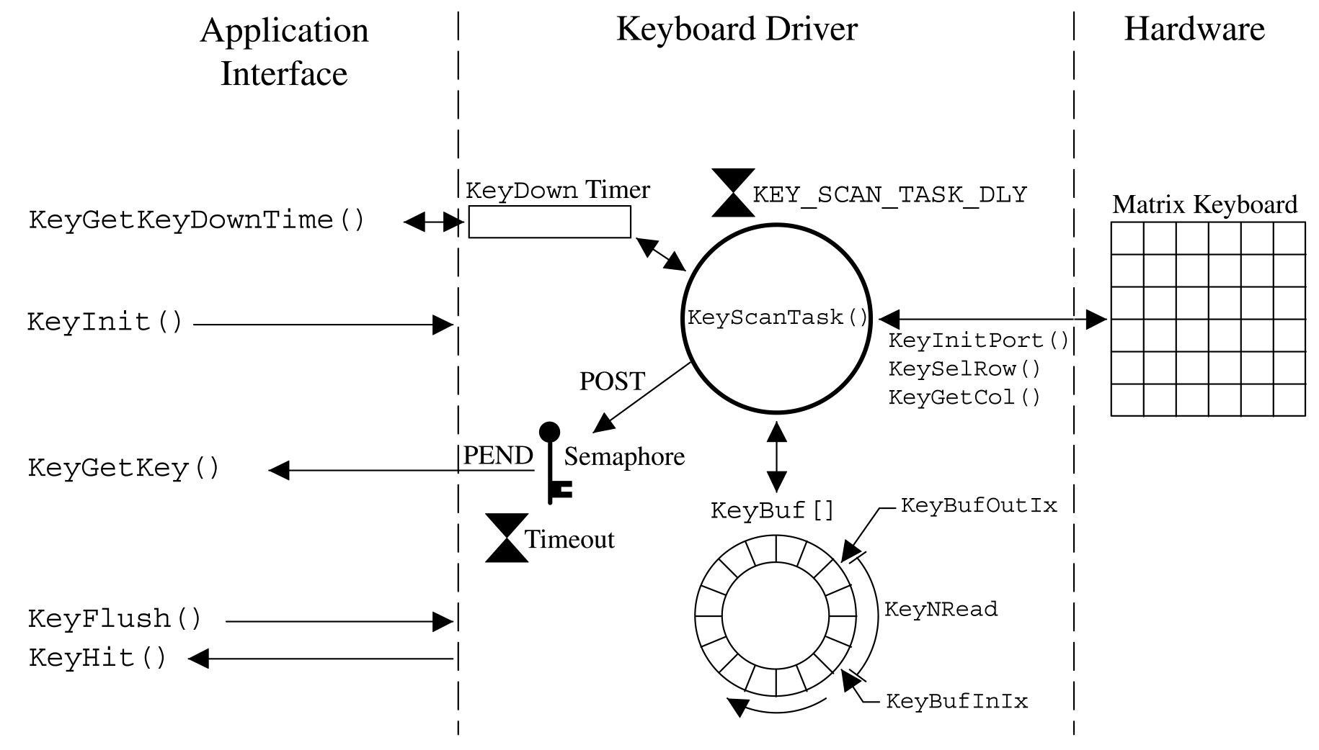
Keypad Driver

Slide 141

Keypad Driver

Slide 142
Serial device driver design for uCOS-II
Design philosophy
  Use real time kernel’s feature
  Provide simple user API
  Encapsulate kernel objects (semaphores)
  Flow control not supported
  API must allow communication tasks to be blocked with timeout until the buffers are available.

Slide 143

Serial device driver design for uCOS-II
Asynchronous serial communication basics
  Two devices can communicate each other using only three wires Rx, Tx, and GND
  (handshaking requires more wires)
  Timing diagram

Slide 144
Serial device driver design for uCOS-II
Processor and UART(Universal Asynchronous Receiver Transmitter)
  UART
    External and internal type
    Receive and Transmit buffer
    (Enhanced UART is equipped with tens of FIFO buffers)
    Able to generates interrupt
    Status and command registers
  Processor
    UART interrupt accept mechanism
    Able to read or write data from or to UART

Slide 145

Serial device driver design for uCOS-II
When UART generates interrupt?
  When a byte has been arrived into Rx Buffer in the UART
  When a byte transmission has completed.

Slide 146
Serial device driver design for uCOS-II
What must be done when interrupt occurs?
  Receiving
    Processor must read the data from the Rx buffer before another data comes in
  Transmitting
    If there were other data to be sent, simply write next data into Tx Buffer
    If not, just return to the background process

Slide 147

Serial device driver design for uCOS-II
Buffering (Ring buffers)
  Simply One dimension memory array
  Ring buffer has head and tail index to manage data
Writing to Ring buffer
...
Head++;
if(Head >= BUFF_SIZE) Head = 0;
RingBuf[Head] = data;
Reading from Ring buffer
Tail++;
if(Tail >= BUFF_SIZE) Tail = 0;
data = RingBuf[Tail];

Slide 148
Serial device driver design for uCOS-II
How to encapsulate semaphores in the driver
  Receiving
    Task waiting for Rx data needs to be blocked if no data is available in the ring buffer
    So, data reading function must provides a mechanism to block calling task with semaphore
    When a one byte arrives, receiving ISR is executed
    ISR saves data into ring buffer and signals the semaphore
    Finishing ISR, task scheduling occurs if blocked task is highest priority. The blocked task resumes
    Rx semaphores must be initialized as event signaling semaphore. rxSem = OSSemCreate(0);

Slide 149
Serial device driver design for uCOS-II
  Transmitting
    Before transmitting, data to be sent need to be stored into tx ring buffer. Storing function must check if the buffer is full or not
    If the ring buffer is full, it must be blocked until at least one room is empty
    The rooms in the buffer will be available automatically by transmitting ISR
    Transmitting ISR must signal Tx semaphore when returning to the interrupted task
    Tx semaphore must be initialized as counting semaphore
    txSem = OSSemCreate(TX_BUFF_SIZE);

Slide 150
Serial device driver design for uCOS-II
Initialization
  rxSem is initialized as event counting semaphore
  txSem is initialized as counting semaphore
void serialInit(void)
{
...
pbuf = &ComBuf;
pbuf->RingBufRxCtr = 0;
pbuf->RingBufRxInPtr = &pbuf->RingBufRx[0];
pbuf->RingBufRxOutPtr = &pbuf->RingBufRx[0];
pbuf->RingBufRxSem = OSSemCreate(0);
pbuf->RingBufTxCtr = 0;
pbuf->RingBufTxInPtr = &pbuf->RingBufTx[0];
pbuf->RingBufTxOutPtr = &pbuf->RingBufTx[0];
pbuf->RingBufTxSem = OSSemCreate(COMM_TX_BUF_SIZE);
Hardware init (baud rate, start bit, ..)
}

Slide 151
Serial device driver design for uCOS-II
Reading from buffer
  Note that caller will be suspended if rxSem is not signaled state
  The caller will be ready to run if rxSem is signaled by ISR
INT8U CommGetChar (INT16U to, INT8U *err)
{
OSSemPend(rxSem, timeout, &oserr);
if(check time out){
Store error code and return;
}
else
{
Read one byte from ring buffer;
}
}

Slide 152
Serial device driver design for uCOS-II
Receiving ISR
  Before storing data, first check the room of ring buffer for new data
  If room is available, store it and signal rxSem
void RxIntHandler(void)
{
if(buffer has a room for new data){
Store the data into ring buffer;
OSSemPost(rxSem);
}
else
{
/* Receive buffer overflow occurred! */
}
}

Slide 153
Serial device driver design for uCOS-II
Storing to buffer
  First, check room availability of buffer for storing
  If available, store a byte into buffer
  If there is only one byte available, enable tx interrupt
INT8U CommPutChar (INT8U c, INT16U to)
{
...
OSSemPend(pbuf->RingBufTxSem, to, &oserr);
if (타임아웃) {
에러코드 리턴;
}
데이터 버퍼에 저장 후 경계처리;
if (첫 번째 데이터) {
송신 인터럽트 요청;
}
return (COMM_NO_ERR);
}

Slide 154
Serial device driver design for uCOS-II
Transmitting ISR
  Check if data to be sent are available
  If available, send one byte to UART then signal txSem
  If not available, just return to the task
void TxIntHandler(void)
{
if(any data to send){
Read one byte from ring buffer;
Send the byte to UART;
OSSemPost(txSem);
}
else
{
/* Transmit completed */
}
}

Slide 155
Serial device driver design for uCOS-II
User task examples
void RxTask(void *data)
{
BYTE err;
char sData;
sData = CommGetChar(*err, 10);
if(err) time out occurred;
}
void TxTask(void *data)
{
BYTE i, err, cnt, sentCnt;
char str[30];
...
err = CommPutChar(‘a’, 10);
if(err){
time out err occurred;
you may need to re-transmit data;
}
}

Slide 156
Serial device driver design for uCOS-II
More discussions on serial driver
  Packet communications are mostly used in embedded systems
  Signaling the semaphore for every received data consumes valuable CPU time
  In packet communication protocol, signaling semaphore only when special data is received can reduce the CPU overhead

